Slide 1
Chapter 1
Why Technical People
Needn’t Fear Writing
Notes:
These PowerPoint slides are intended as guides for presentations that follow the structure and content of the text. The wording of some of the bullets is longer than is generally advised (for instance by Chapter 13 on oral presentations) for two reasons: the first is that I post PDFs of the lecture for students to download. The more fully the bullets explain, the easier it is for students to understand. The second is to make it easier for fellow instructors to divine the intent of the bullets. It’s impossible, after all, to fill in the gaps in other people’s presentation slides. Please feel free to edit these slides as you see fit, to better suit your purposes.
The PowerPoint slides use animations to create progressive reveals so that instructors are in control of what the students see. This is a common practice so that, for instance, students are not reading bullets 2, 3, and 4, while the instructor is still discussing bullet 1. However, if you would rather not work with animations, feel free to turn them off on the Animation Ribbon. Simply highlight the text for which you’d like to remove the animation and select “None” in the effects selection box.

Slide 2
Outline
The role of writing in the technical workplace
Why you can learn to write well
What makes for good technical writing
The writing (and editing) process
Notes:
The PowerPoint slides use animations to create progressive reveals so that instructors are in control of what the students see. This is a common practice so that, for instance, students are not reading bullets 2, 3, and 4, while the instructor is still discussing bullet 1. However, if you would rather not work with animations, feel free to turn them off on the Animation Ribbon. Simply highlight the text for which you’d like to remove the animation and select “None” in the effects selection box.

Slide 3
The Extent of Writing in the Technical Workplace
Continual need for record keeping
You can’t remember everything that you’ve done.
You can’t always be there to tell others what you’ve done.
Your reports form a permanent record of your work and decisions so that others in your organization can benefit.

Slide 4
The Extent of Writing in the Technical Workplace, cont’d
Your documentation will be used to add to the store of knowledge and experience within your firm and your industry.
Reports record the due diligence with which you’ve performed your tasks, which may have legal implications, may be required to legitimize your findings, may be used to do billing, and so on.

Slide 5
The Extent of Writing in the Technical Workplace, cont’d
The technical workplace works on the free and continual flow of information and must be widely available. Your reports become part of the technical conversation within your company, organization, profession, and even your society.
Record keeping and reporting takes place at every step of a job or project: from inspiration to requests for proposals, to proposals, to acceptance and contract signing, to progress reports, completion reports, and so on.
All the research you do on any project will be courtesy of the writings of others.

Slide 6
The Extent of Writing in the Technical Workplace, cont’d
For these vital reasons, technical professionals spend between 20% and 40% of their workday writing, depending on the industry and their position.
Writing is an integral, indispensable part of every technical person’s toolbox.
Without the ability to write, you are unlikely to succeed in your field.

Slide 7
Technical Writing Isn’t Like Literary Writing
Writing is not a gift; it’s a craft.
It follows rules and is improved by simple guidelines.
Technical writing shouldn’t be fancy; it just needs to convey information clearly.
We use the simplest words and shortest phrases we can; we don’t worry about repetitive language.
We never use more words than necessary; we don’t pad for length or use difficult language to impress.

Slide 8
Technical Writing Isn’t Like Literary Writing, cont’d
As a technical or scientific person, you are well suited to such a no-nonsense communication style.
You are also well suited to working along guidelines and best practices.

Slide 9
Attributes of Technical Writing
Clarity: must be understood the first time it is read by its intended audience
Completeness: must contain all the necessary information for the audience to understand a situation and follow up on it
Conciseness: must be clear, be complete, but do so in as few words as necessary
Accessibility: must be organized and tagged (headings, bullets, and the like) to make information easy to find
Accuracy: must be free of grammatical and mechanical errors
Correctness: must free of factual errors

Slide 10
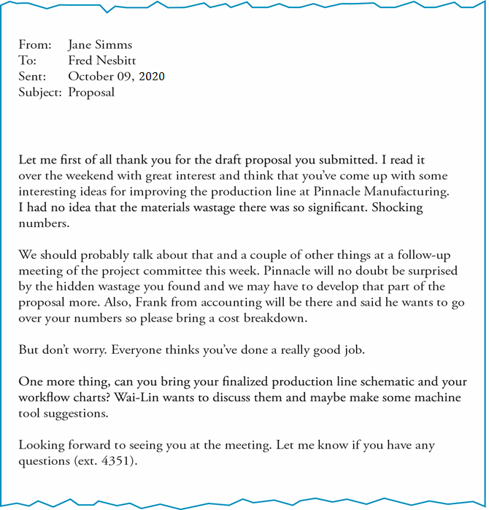
Not concise: Most of the first paragraph is a long and unnecessary preamble to the main idea.
Unclear/incomplete subject line: Is this a proposal? No. It’s about a proposal, but which one? This subject line does not provide sufficient information.
When is this meeting? This email does not provide complete and necessary information.
Information is not accessible: Meeting items are spread throughout the email and material wastage is mentioned twice.
Notes:
This is the bad email sample (Figure 1.1). Use it to discuss what makes this email ineffective. The discussion points are illustrated in the text

Slide 11
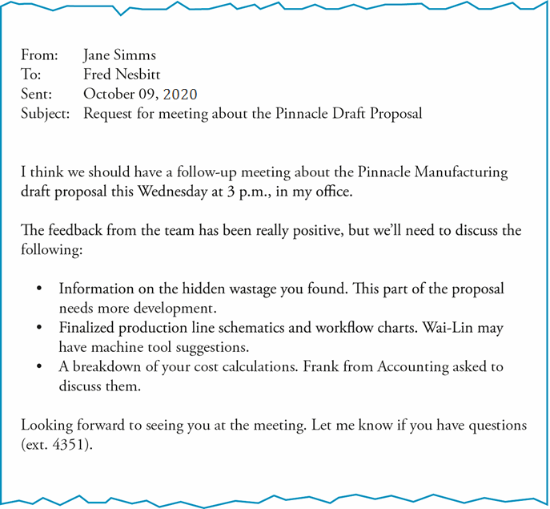
Unclear/complete subject line: this email is a request for a meeting on a specific proposal
The opening statement identifies the main idea clearly and concisely
This email includes the meeting time, providing all the information the reader will need to show up for the meeting (and prepare for it).
The meeting items are gathered in one location and highlighted with bullets, making the key information easily accessible
Notes:
This is the good email example (Figure 1.2). Use it to discuss what makes an email effective. Discussion points are illustrated in the text.

Slide 12
The Writing Process
Everything goes better if you have a plan; writing is no different.
Even short documents, like the emails we just looked at, work better if you work to a plan.

Slide 13
The Writing Process, cont’d
The writing process
Determine the purpose of your document.
Consider the audience.
Brainstorm the content.
Organize the content.
Determine the correct writing style.
Write the first draft quickly, without stopping.
Revise in stages.
Notes:
We’ll look at each of these stages in turn to get an opportunity how writing is (or should be) done in the workplace.
Each step is an opportunity to discuss how writing functions.

Slide 14
1. Determine the Purpose
Know exactly what your document is intended to accomplish.
Focus on this purpose and exclude all information that is not relevant to it.
The purpose focuses the document and makes it easy to come up with a clear opening statement and subject line/heading.

Slide 15
2. Consider the Audience
Different audiences require different kinds of information and/or persuasion.
Decision makers require managerial information: costs, outcomes, general procedures. Summaries help them get the gist of your document. Context helps them understand how your document fits into the organization’s work as a whole.
Experts require technical details and clear process descriptions. They have the technical know-how to assess the merit of your idea and its feasibility.

Slide 16
2. Consider the Audience, cont’d
Agents implement the ideas in your document; they require clear instructions formatted for easy reference.
General readers are non-technical and may be outside your organization; they require definition of terms, clear descriptions of basic concepts and processes.

Slide 17
3. Brainstorm the Content
Once you know what you want to accomplish and to whom you’re speaking, brainstorm the content.
Just set down the information that your particular reader(s) need(s) in order to understand what you need them to understand.

Slide 18
4. Organize the Content
Reorganize the brainstormed information for proper flow.
Correspondence is like a one-way conversation with your reader.
Reports tell stories.
Notes:
Obviously these are only rough analogies, but should prove helpful while students are structuring their documents.

Slide 19
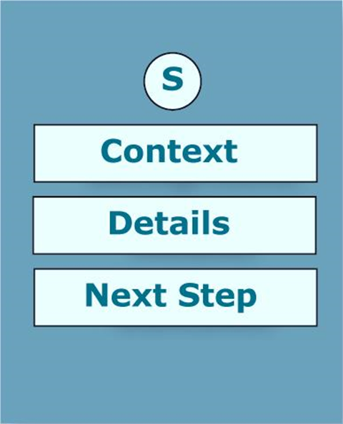
What do you want? How can I help you?
Why are you telling me this?
What’s this got to do with me?
Okay, now tell me exactly what happened or exactly what you need.
What have you done about this? What do you need me (or someone else) to do?

Slide 20
The main point(s), called the summary in a report.
Context or background for the report; tells how the report came to be written.
All the relevant facts, findings, and specifics of the report situation.
What needs to happen next. What you have done or what you need the reader to do.

Slide 21
5. Determine the Style
Some situations require greater formality.
If you were speaking to your reader (instead of writing), how formally would you speak?
Use much the same tone in your writing.
Remember though, that all writing in business is more formal than emails sent to friends.

Slide 22
6. Write the First Draft Quickly
You now know what you are going to write, in what order, and in what tone.
Now imagine yourself sitting across the desk from your reader and write your first draft quickly and without stopping to edit.
Write pretty much what you would say.
Your first draft should flow pretty smoothly.

Slide 23
7. Revise in Four Stages
All writing requires editing.
Edit in four stages, proceeding from large changes to small:
Substantive editing: Adjust and reorganize the content, if necessary.
Stylistic editing: Create proper style and tone, and ensure clarity.
Copy editing: Edit for grammar, punctuation, and mechanics.
Proofreading: Format the document.
There’s no point in editing sentences for style before you’ve made sure they appear in the proper place within the document, no point in worrying about punctuation before you’ve put all your words in place.

Slide 24
Final Word
Writing well is not magic, but a learnable technique.
Employ the writing guidelines from today’s lecture and in the lectures on sentences (Chapter 2) and paragraphs (Chapter 3) and your writing is guaranteed to improve.

