Slide 1
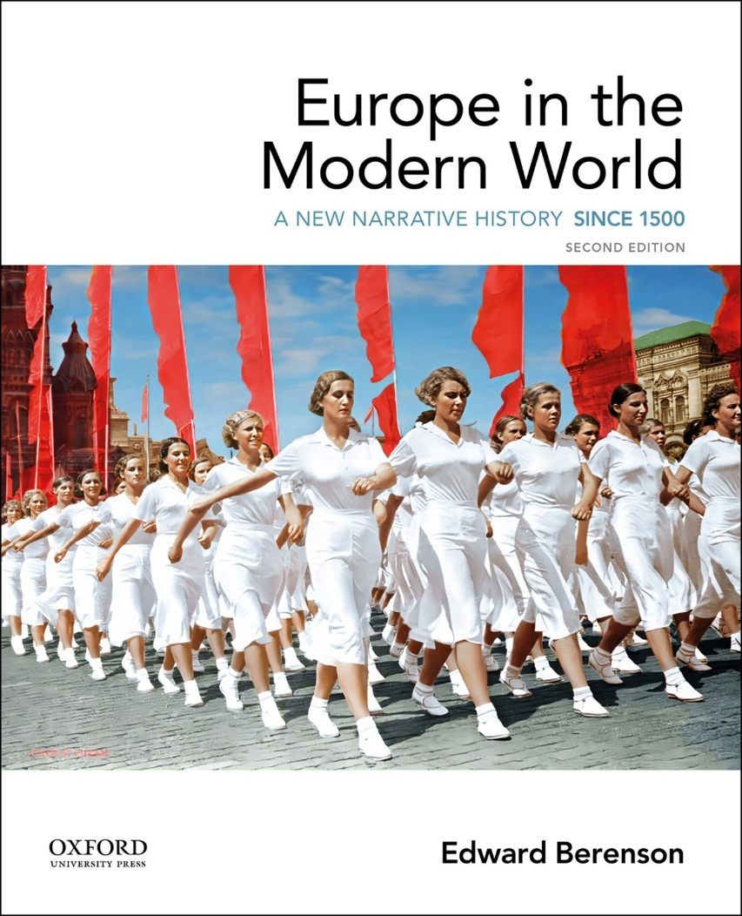
Europe in the Modern World by Edward Berenson

Slide 2
Chapter 03 Crises of the Seventeenth Century

Slide 3
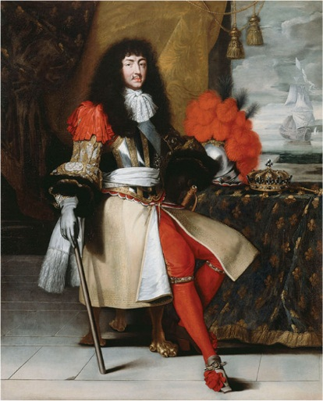
Louis XIV

Slide 4
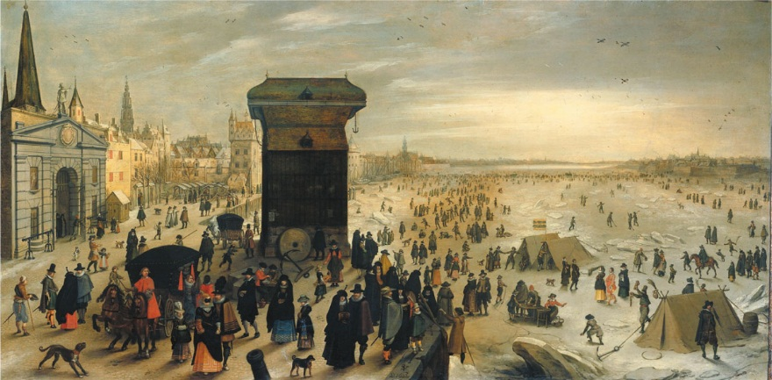
Ice City. The citizens of Antwerp in the Spanish Netherlands (now in Belgium) enjoy winter pastimes on one of the city’s many frozen waterways during the winter of 1622–1623.

Slide 5
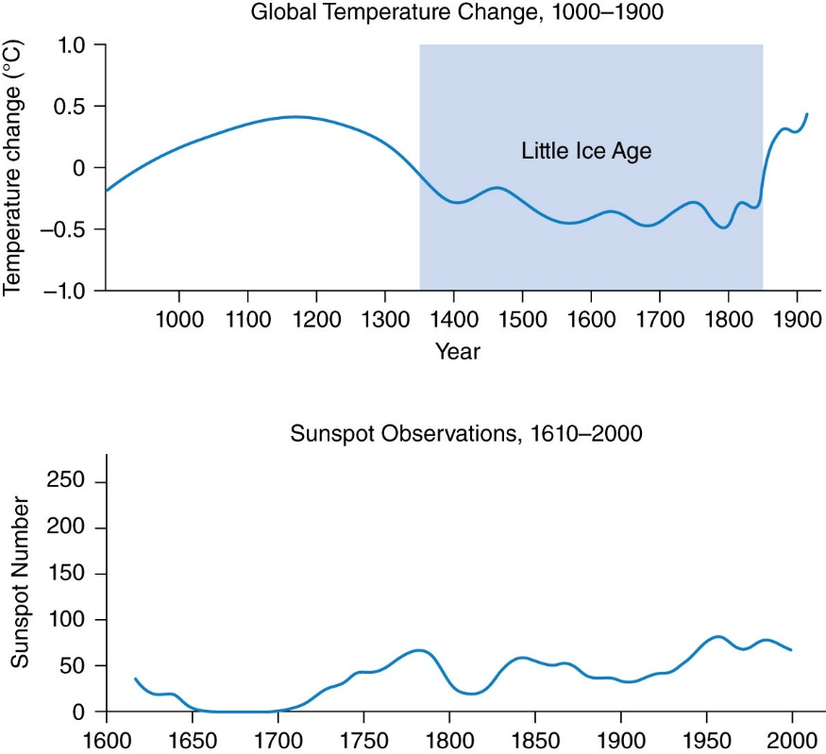
Figure 3.1 Global Temperature Change, 1000–1900, and Sunspot Observations, 1610–2000

Slide 6
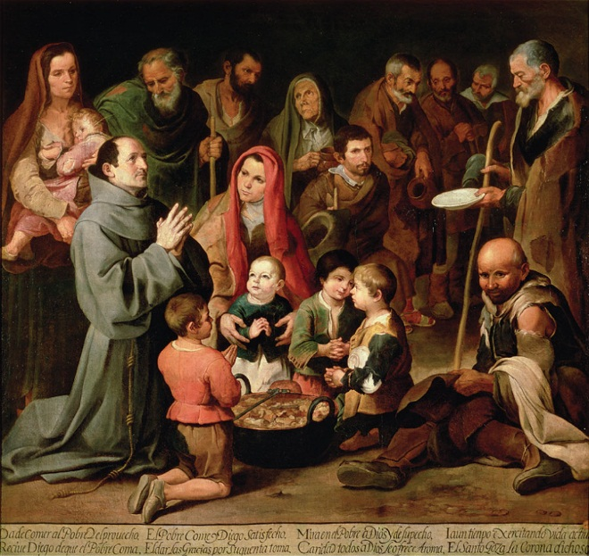
Feeding the Poor. In this painting from about 1646 by the Spanish painter Bartolomé Esteban Murillo, solemnlooking children and the elderly give thanks to the kneeling St. Diego of Alcalá for a ration of food. Seville, where Murillo spent most of his life, suffered several crop failures, disastrous floods, and repeated outbreaks of famine and the plague between 1626 and 1679.

Slide 7
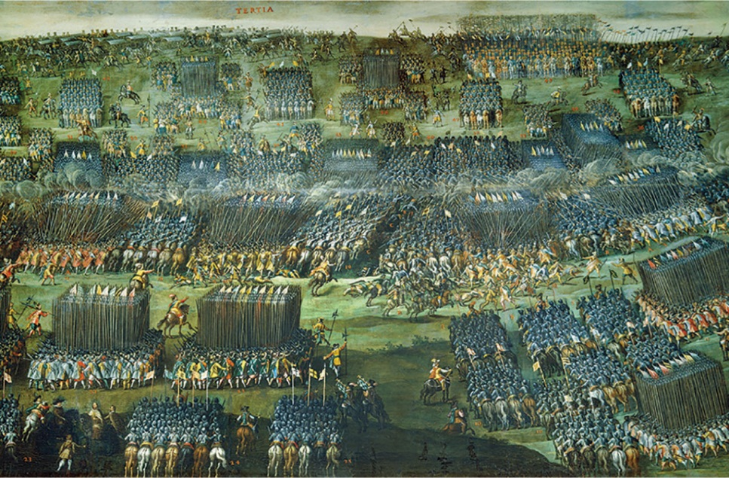
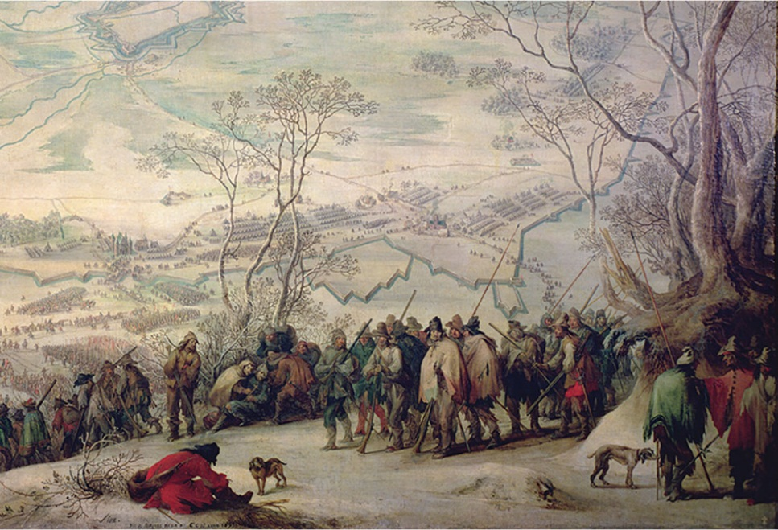
A World at Arms. These two paintings by the Flemish painter Pieter Snayers capture the immensity and terrible suffering of the constant fighting that ravaged Europe for most of the seventeenth century. Left: The Battle of White Mountain, a pivotal battle in the early phase of the Thirty Years’ War, in which 50,000 soldiers fought. Right: The siege of Aire-sur-la-Lys, in northern France, 1641. Starving Spanish soldiers freeze in the snow. Visible behind them are the fortifications of the town.

Slide 8
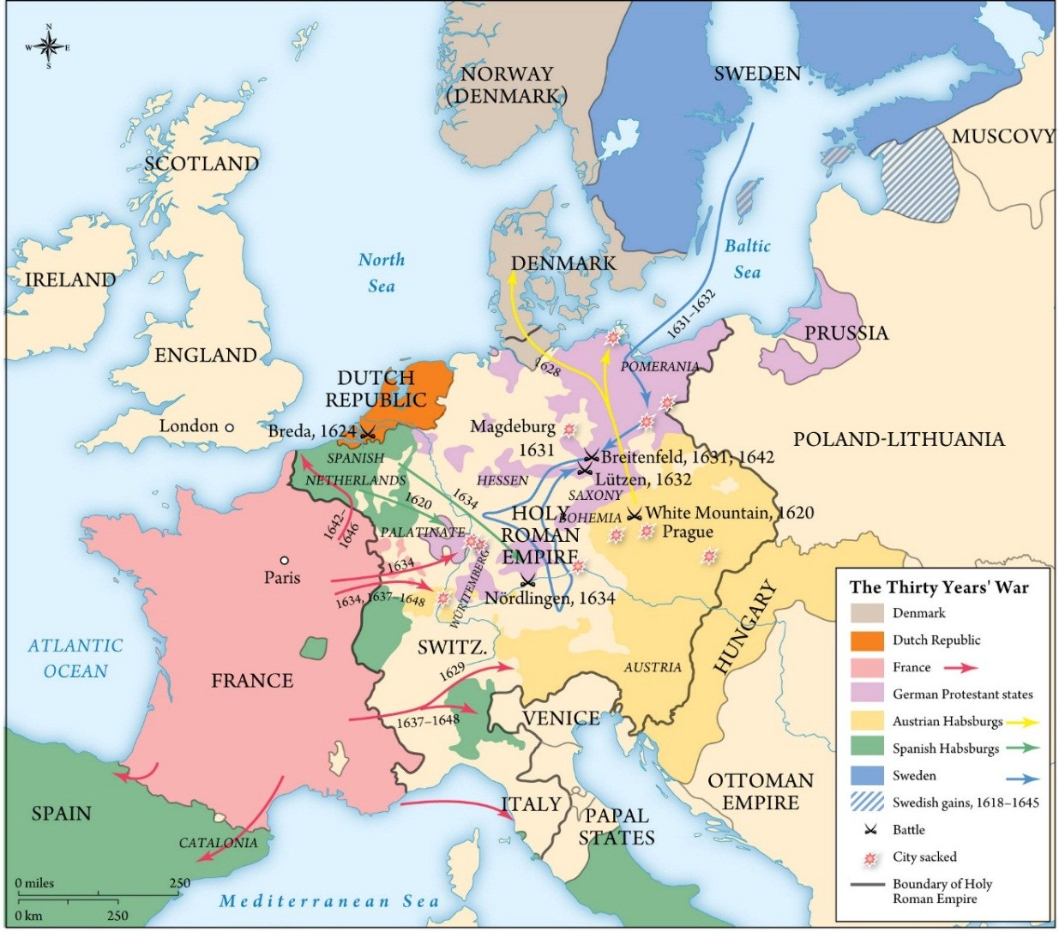
Map 3.1 The Thirty Years’ War

Slide 9
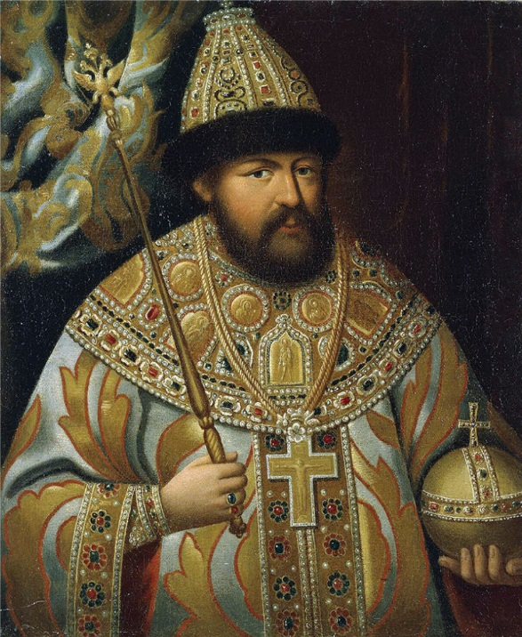
Tsar Alexei of Russia. The long reign of Alexei (1645–1676) was filled with crises, and the tsar relied on advisers who often failed him. In this painting, Alexei wears the royal regalia that symbolize his sovereignty and legitimate his rule.

Slide 10
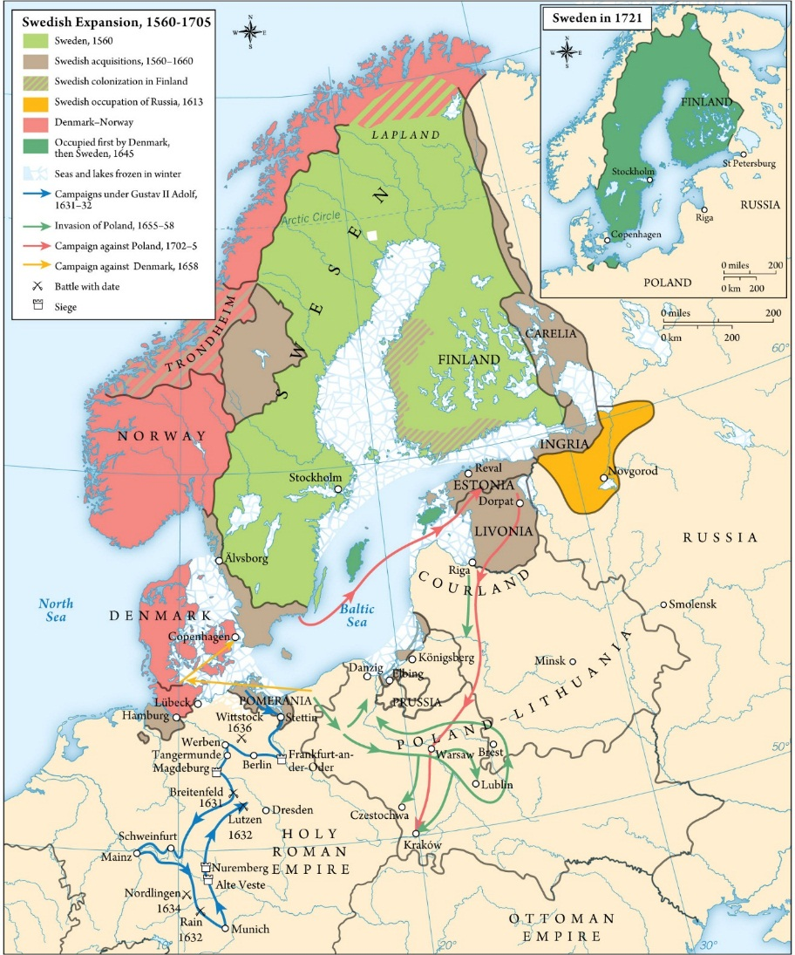
Map 3.2 Sweden Expansion, 1560–1705

Slide 11
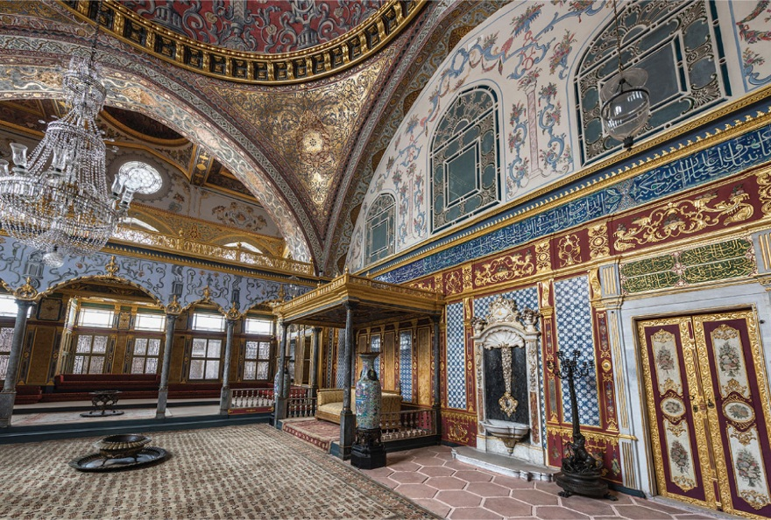
Imperial Hall, Topkapi Palace. Shortly after they conquered Constantinople, the Ottomans began the construction of a new palace for their sultans: Topkapi Saray. The Topkapi is a veritable mini-city, with schools, barracks, a hospital, an armory, and most important, the living quarters, or harem, for the ruling family. Located at the very center of the palace complex were the private apartments of the sultan, which included the Imperial Hall where the sultan would receive members of his family and closest advisors.

Slide 12
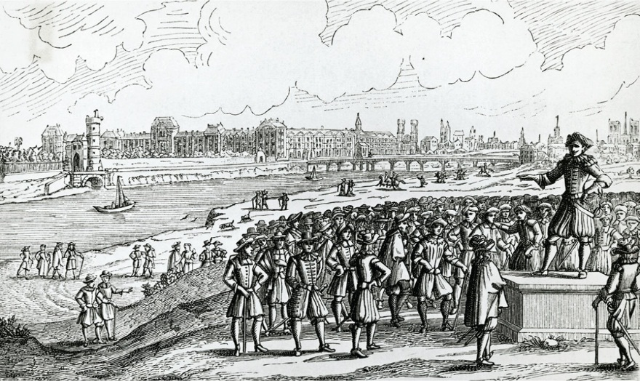
The Fronde. A Fronde leader urges Parisians to revolt against Cardinal Mazarin. The Seine, visible in the background, flooded its banks numerous times in the seventeenth century.

Slide 13
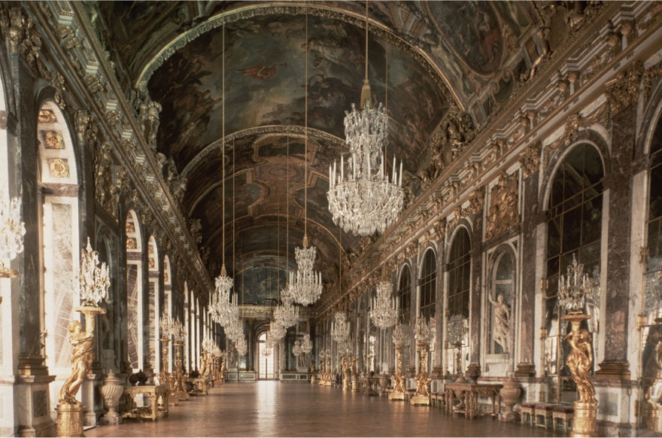
The Chateau of Versailles—Hall of Mirrors. In this ornate palace, completed in 1682, King Louis XIV presided over some 5,000 of his country’s leading nobles and shaped an ambitious, adventurous foreign policy.

Slide 14
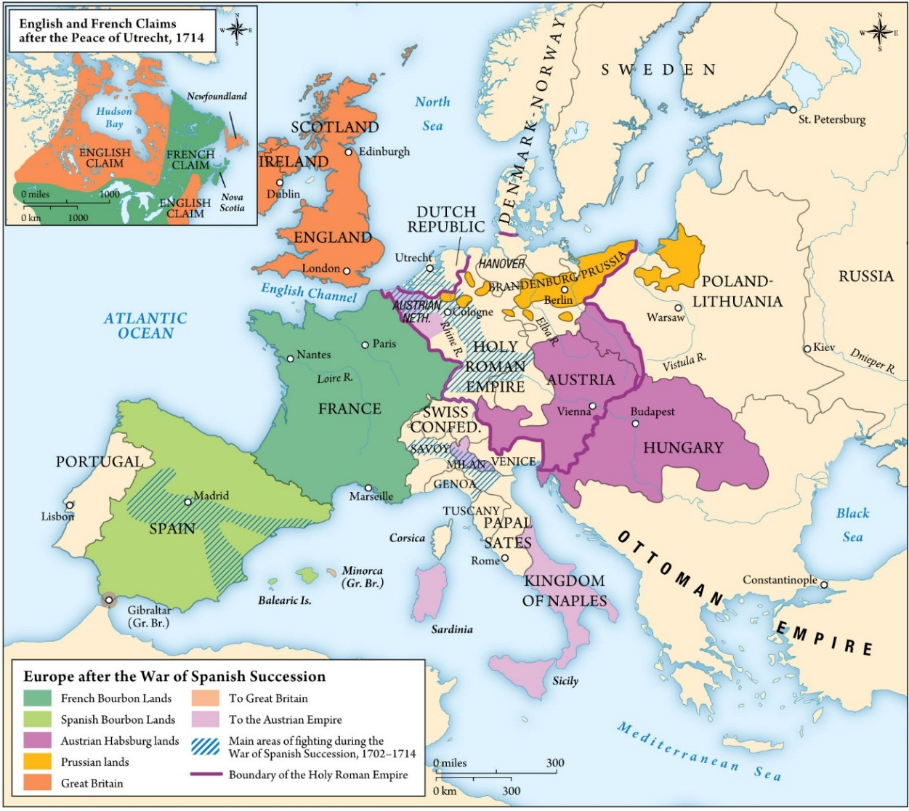
Map 3.3 Europe after the War of the Spanish Succession

Slide 15
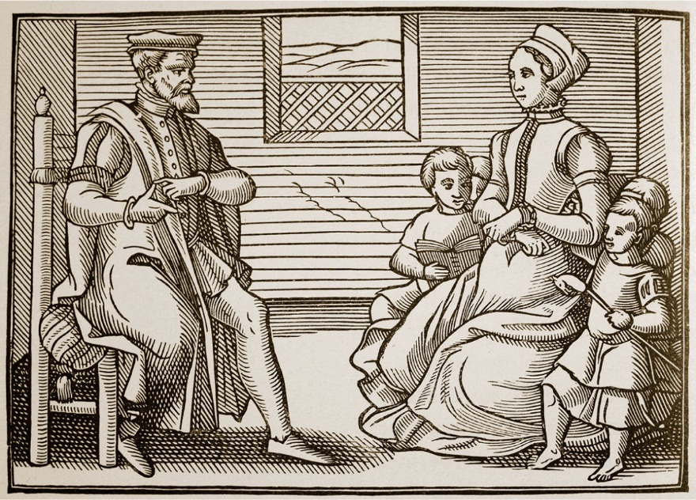
Puritans. These Protestant purists disliked elaborate religious ritual and thought England’s sumptuous Anglican cathedrals smacked of Catholicism. Puritans considered William Laud, King Charles I’s Archbishop of Canterbury, a papist.

Slide 16
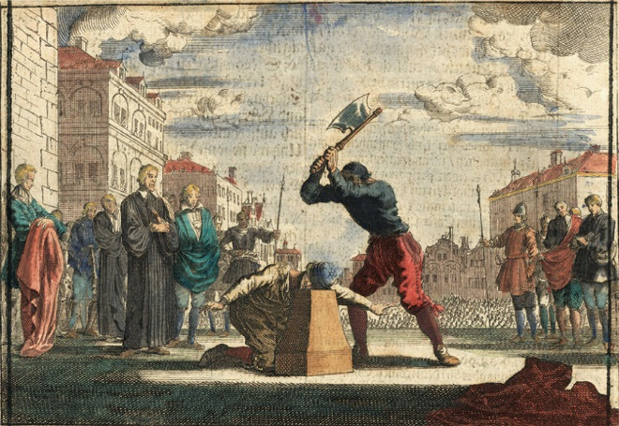
The Execution of Charles I. In January 1649, England’s revolutionary “Rump Parliament” indicted Charles for treason, and a newly created High Court sentenced him to death. The execution shocked a great many English people and polarized a deeply divided country all the more.

Slide 17
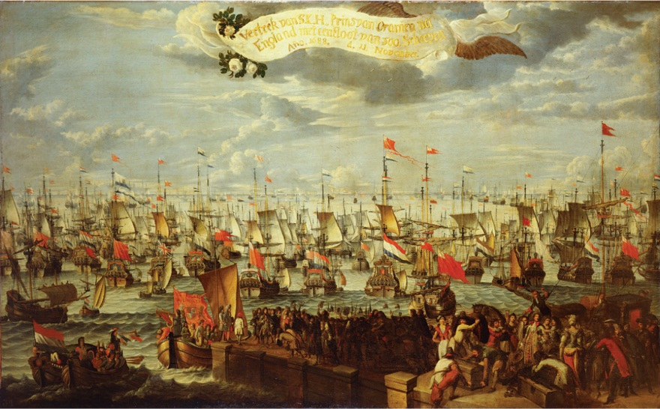
Glorious Revolution. This dramatic event deposed England’s quasi-Catholic King James II and imported a Dutch Protestant nobleman to take his place. The revolution forbade Catholics to occupy the English throne and increased the powers of Parliament at the monarchy’s expense.

Slide 18
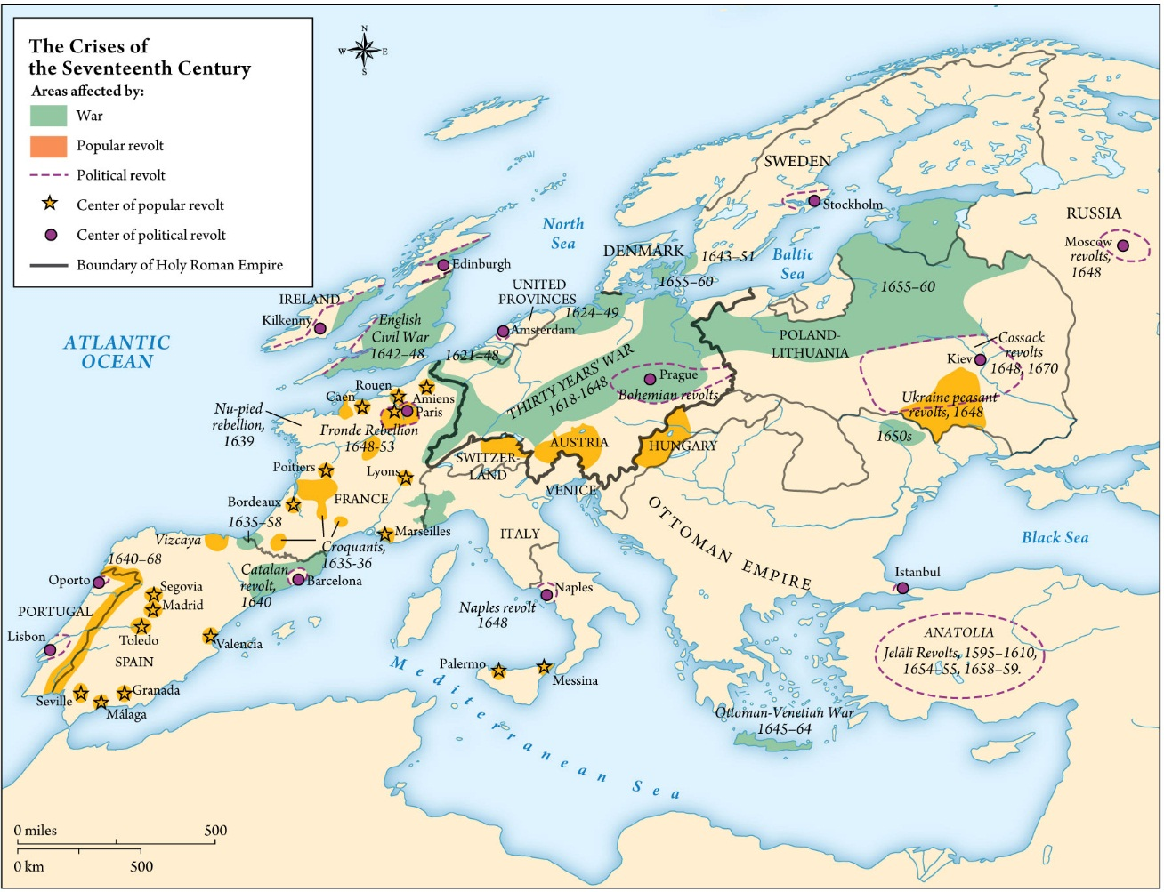
Map 3.4 The Crises of the Seventeenth Century

