Slide 1
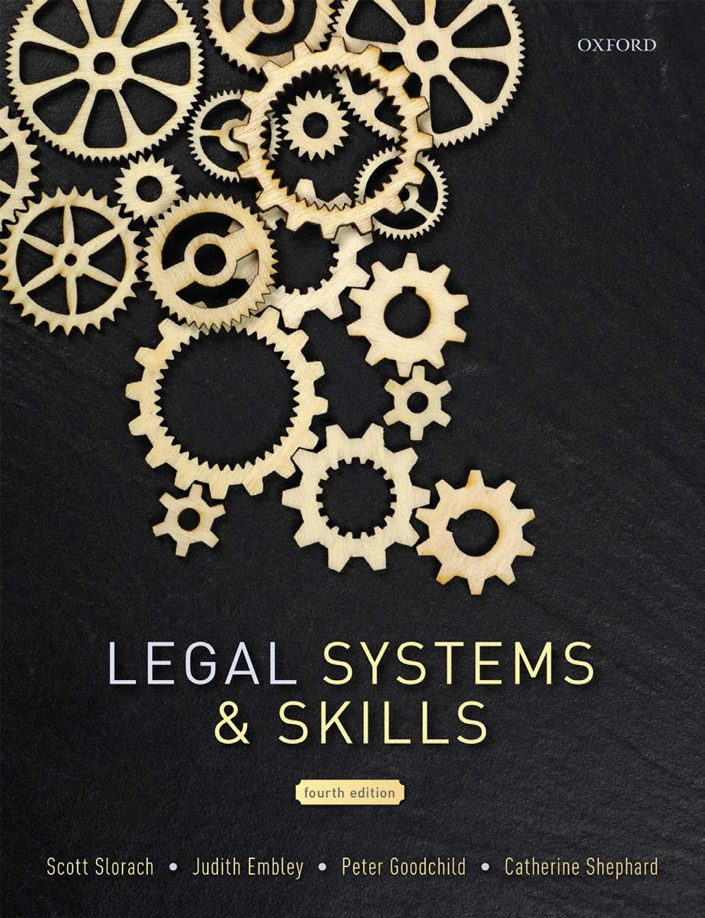
Legal Systems & Skills
by Scott Slorach, Judith Embley, Peter Goodchild and Catherine Shephard

Slide 2
Part 1
Legal Systems
Chapter 01
Introduction to law

Slide 3
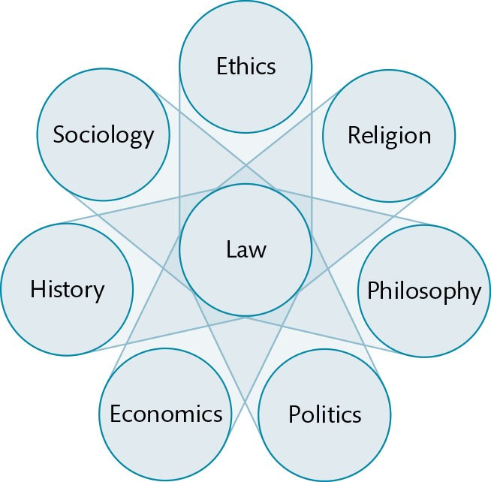
Figure 1.1 Law at the centre of an interconnected range of academic disciplines

Slide 4
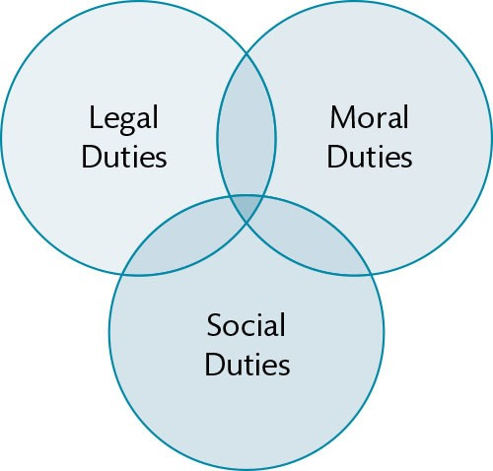
Figure 1.2 Overlap between legal, moral, and social duties

Slide 5
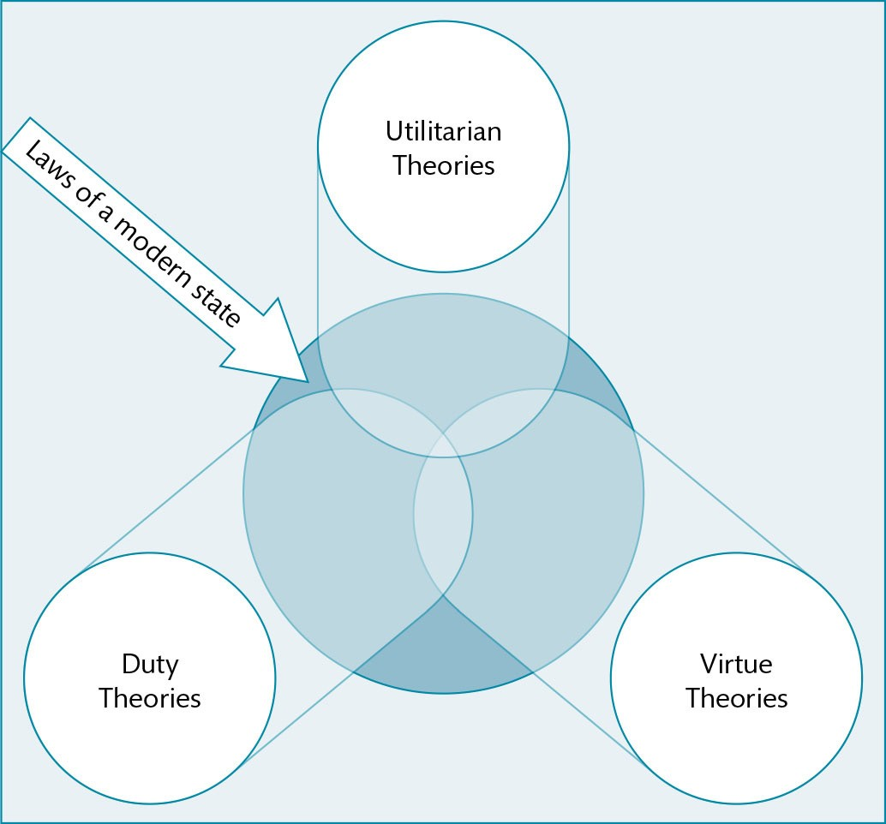
Figure 1.3 Moral ancestry of the modern state

Slide 6
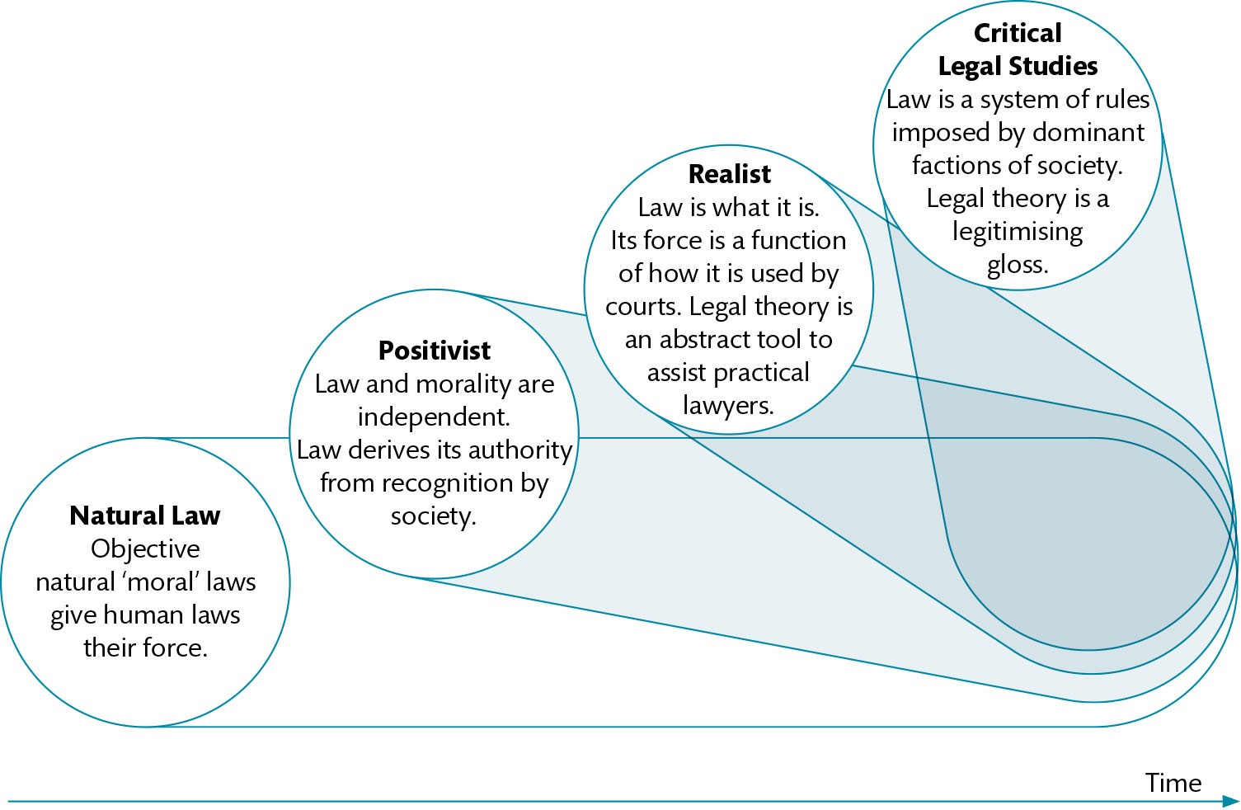
Figure 1.4 The historical development of approaches to jurisprudence

Slide 7
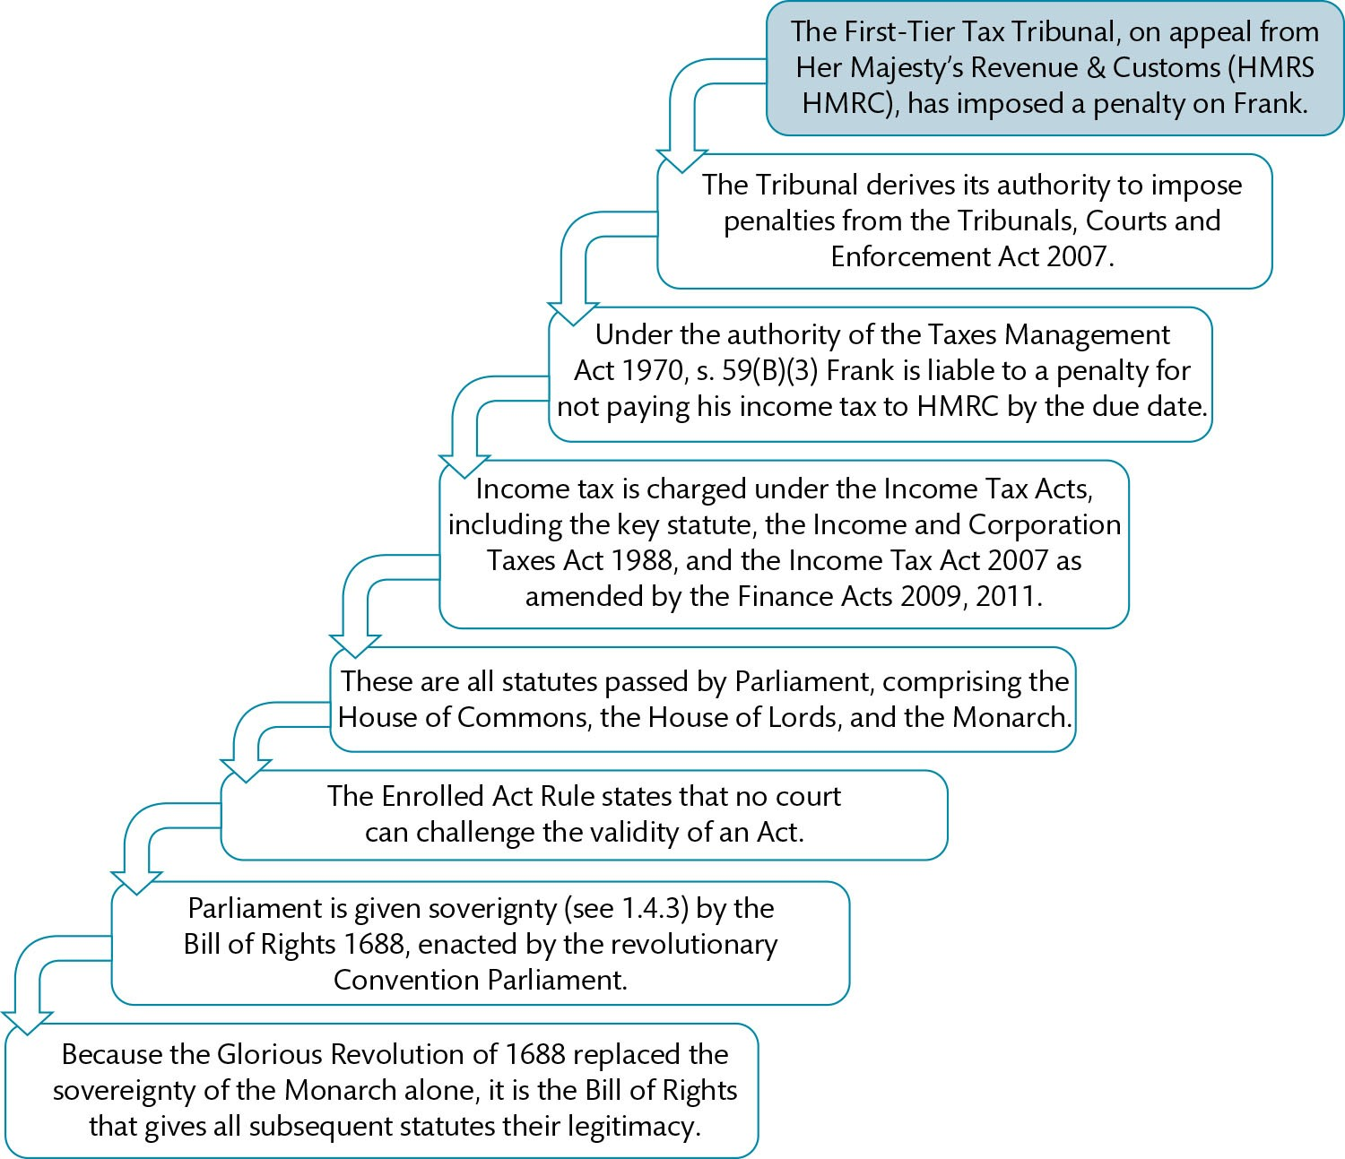
Figure 1.5 Legitimacy of legal rules: example

Slide 8
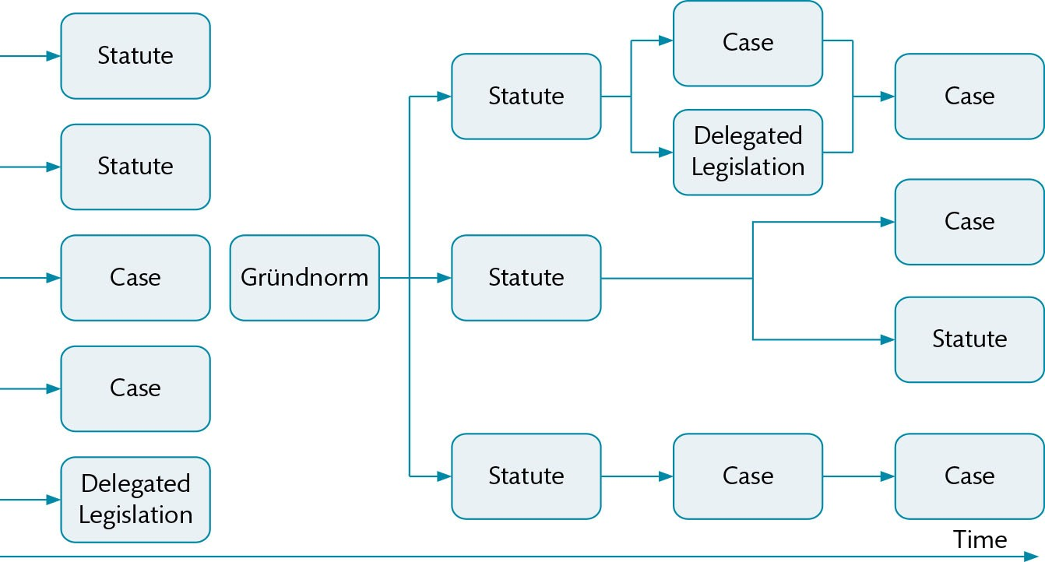
Figure 1.6 Role of the gründnorm in justifying subsequent law

Slide 9
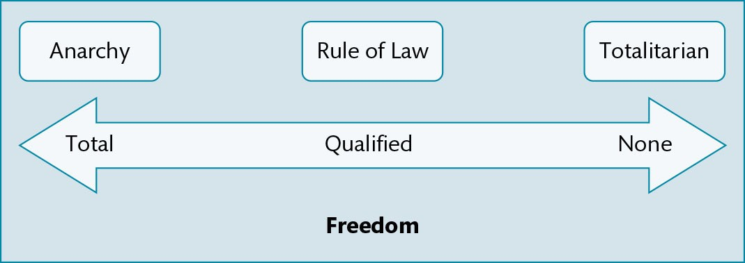
Figure 1.7 Relationship between personal freedom and types of state

Slide 10
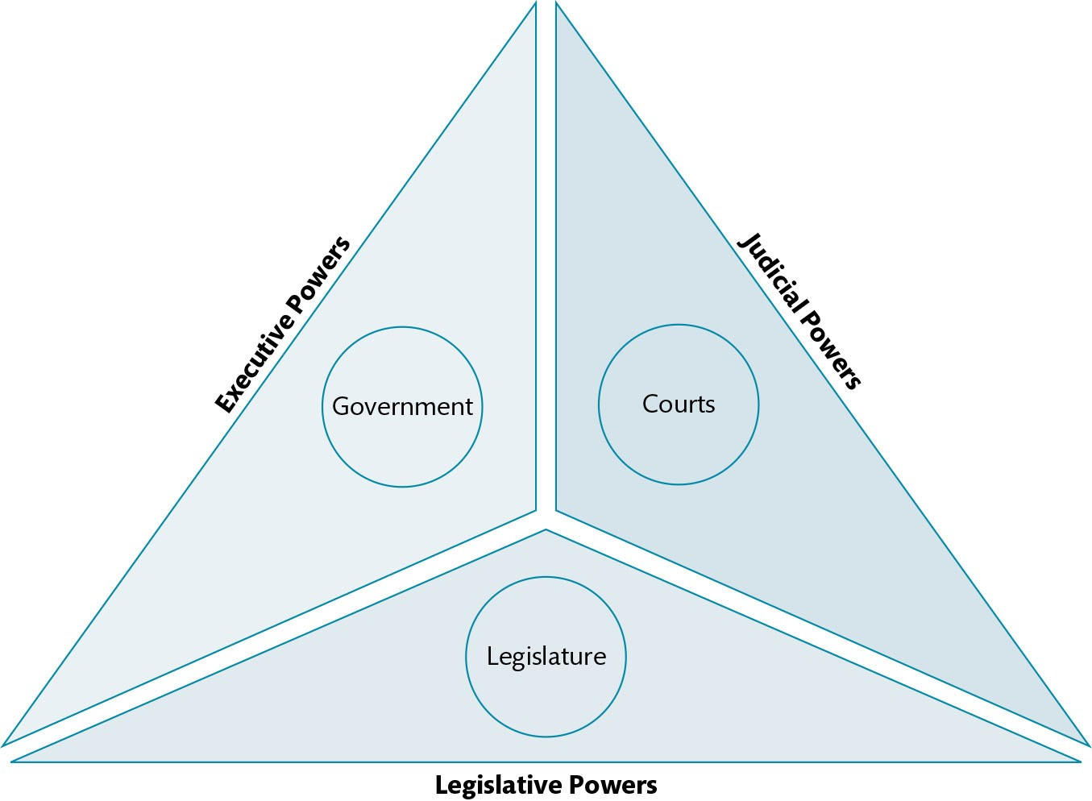
Figure 1.8 The Separation of Powers

Slide 11
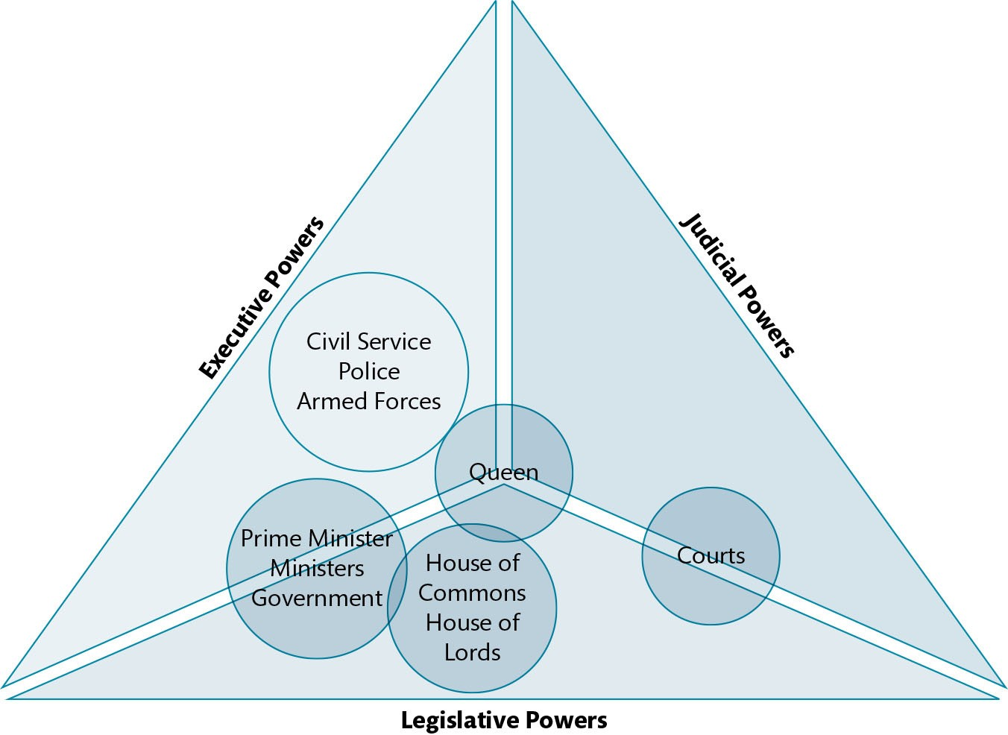
Figure 1.9 The Separation of Powers in the UK

