Slide 1
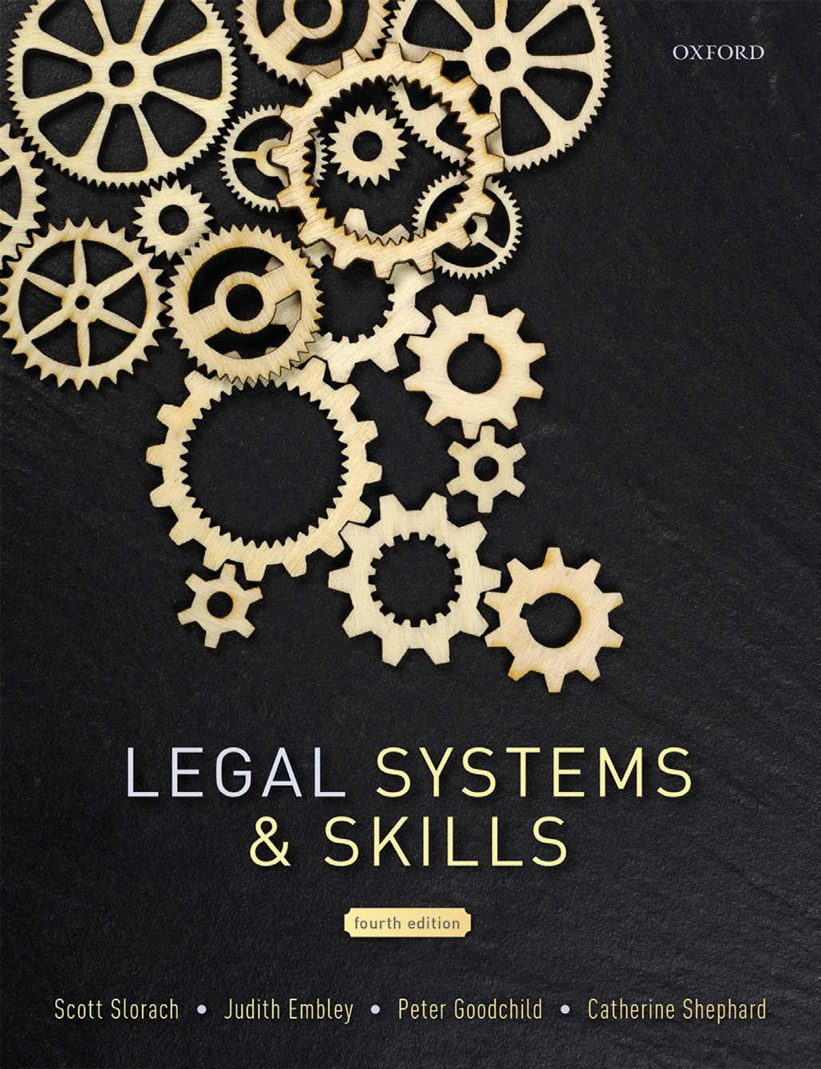
Legal Systems & Skills
by Scott Slorach, Judith Embley, Peter Goodchild and Catherine Shephard

Slide 2
Part 3
Employability and Commercial Awareness
Chapter 17
Understanding clients: individuals and businesses

Slide 3
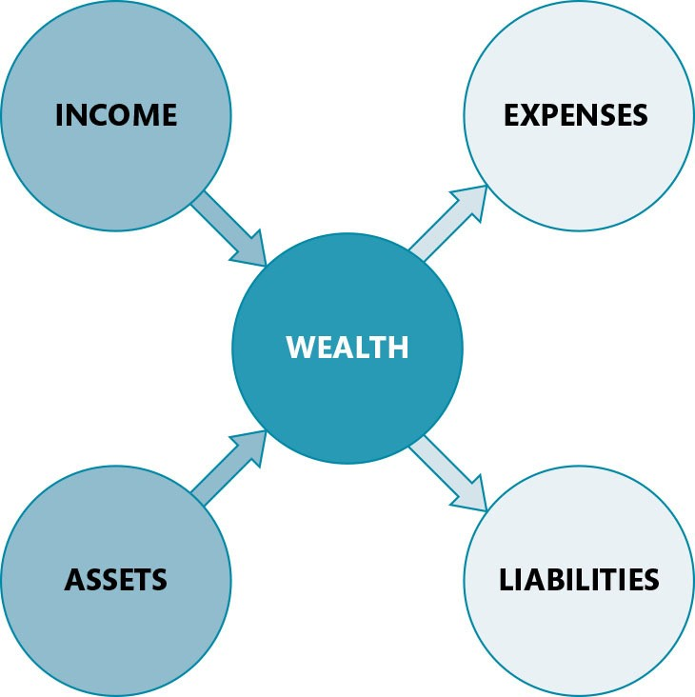
Figure 17.1 Wealth

Slide 4
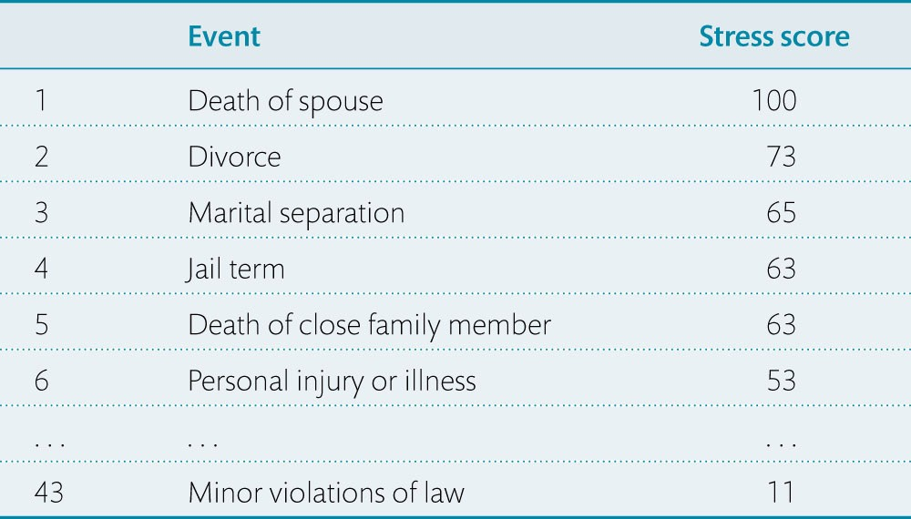
Table 17.1 Extracts from the Holmes and Rahe Stress Scale¹

Slide 5
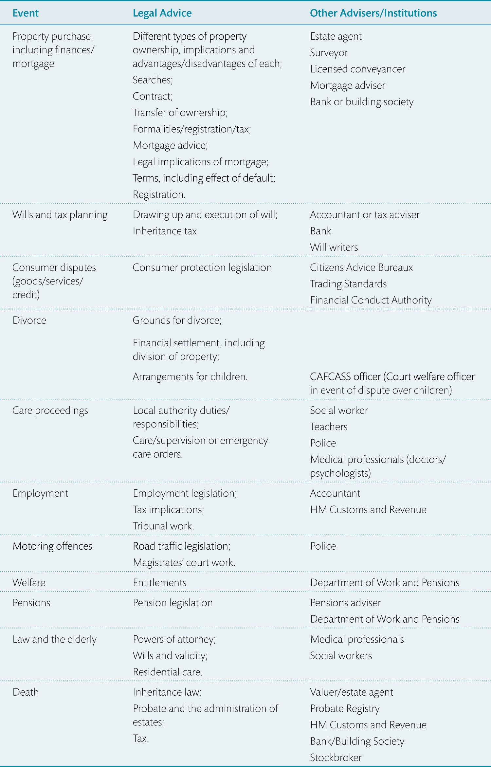
Table 17.2 Life events: legal advice, advisers, and institutions

Slide 6
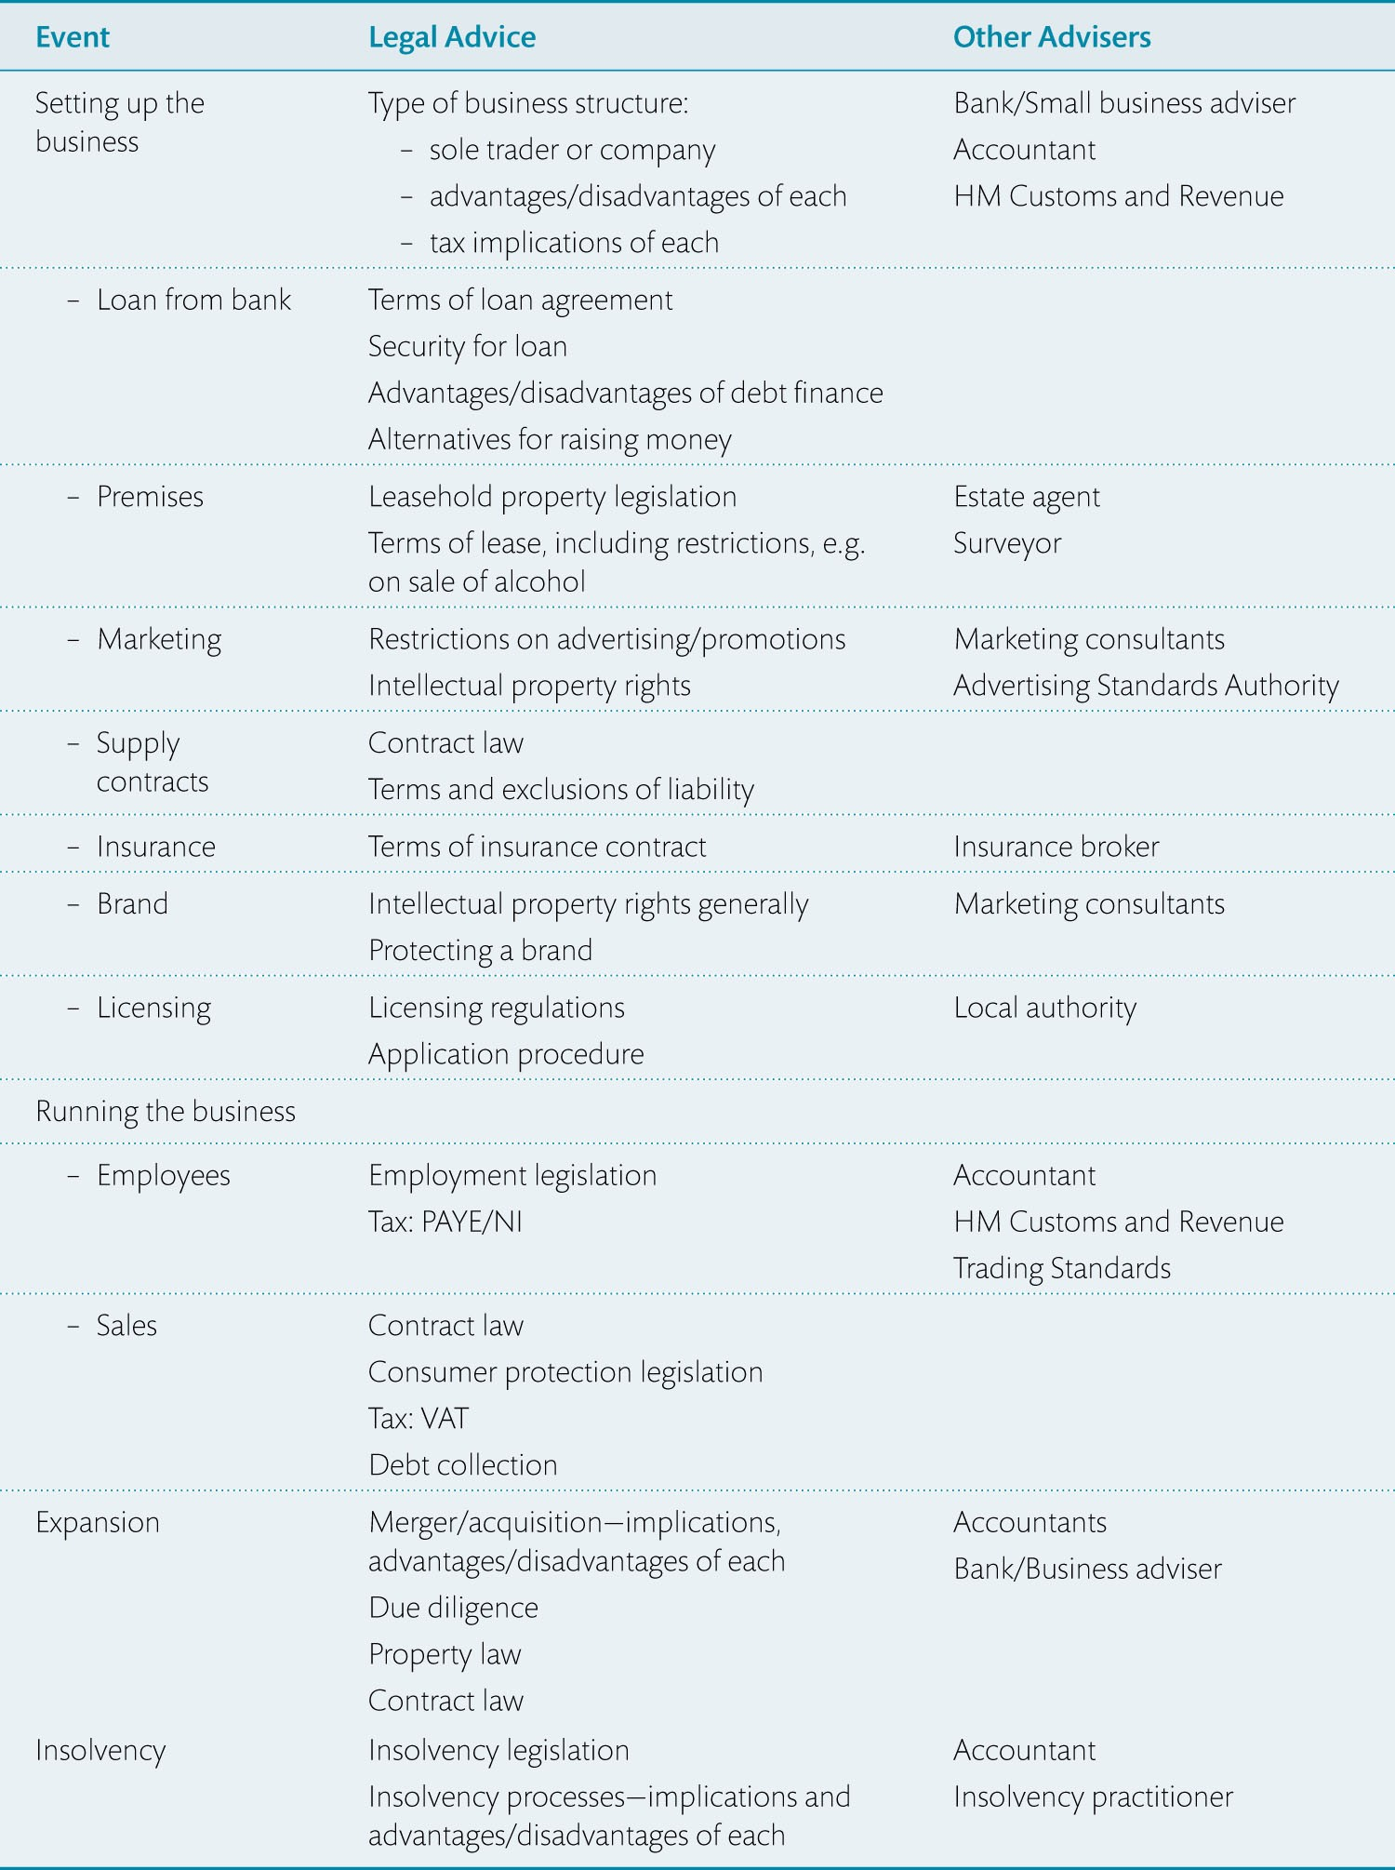
Table 17.3 Business life cycle: legal advice, advisers, and institutions involved

