Slide 1
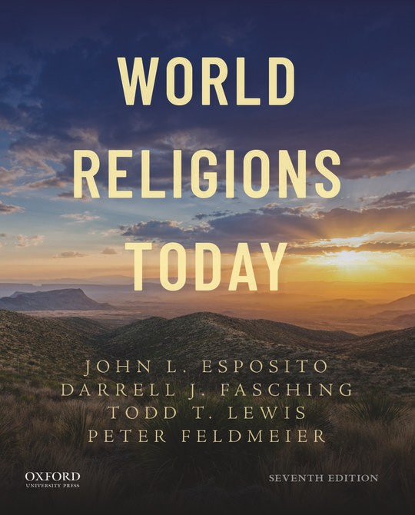
1
World Religions Today
By John L. Esposito, Darrell J. Fasching, Todd T. Lewis, and Peter Feldmeier

Slide 2
Chapter 05
Islam: The Many Faces of The Muslim Experience

Slide 3
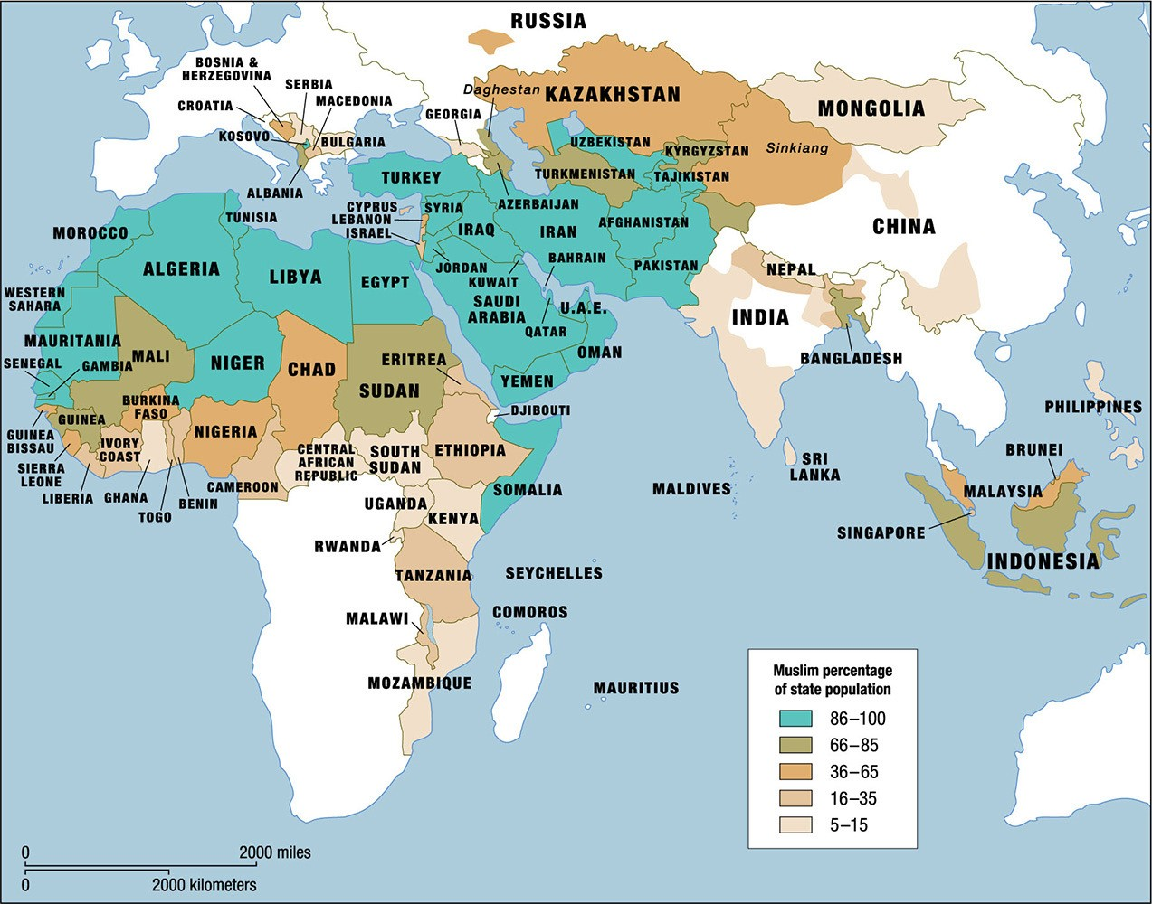
3
Map 5.1 The Muslim world.

Slide 4
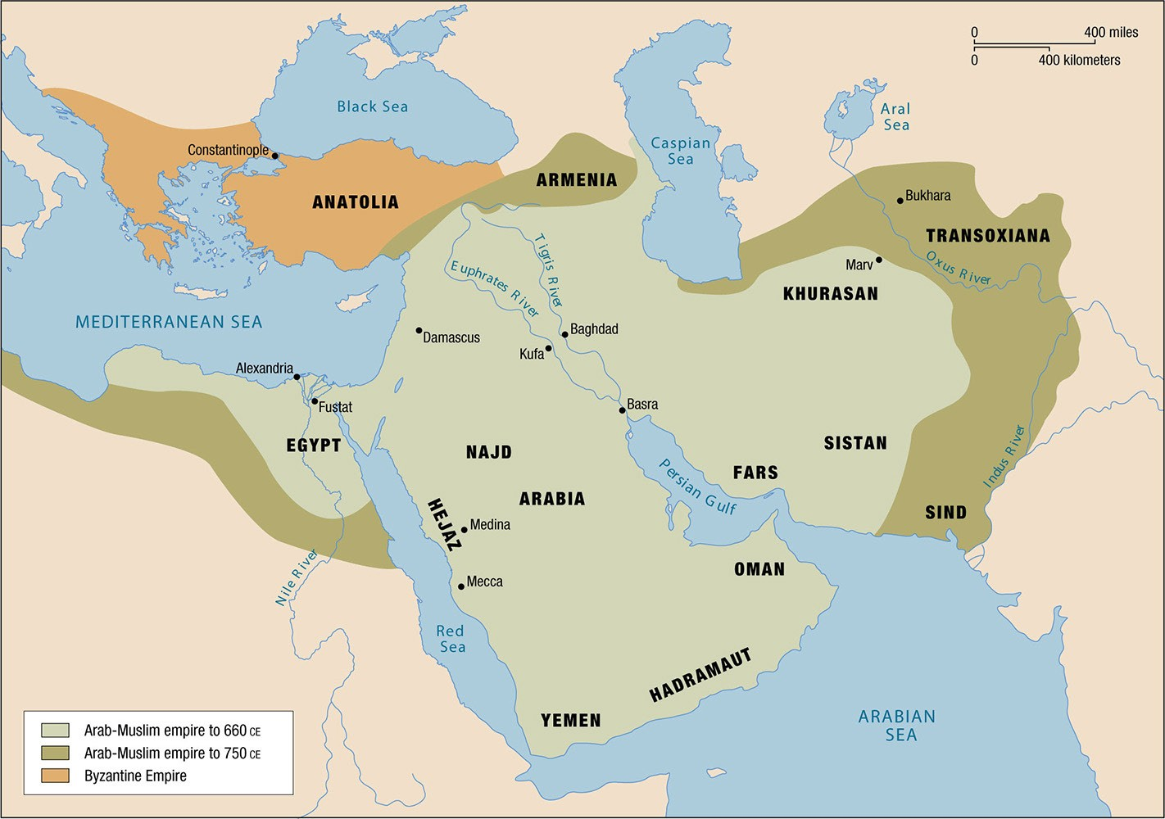
4
Map 5.2 The Muslim Empire to 750 ce.

Slide 5
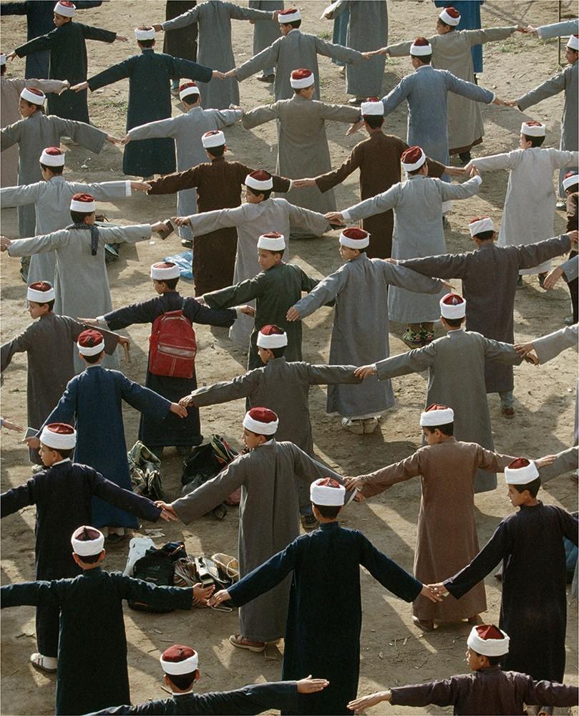
5

Slide 6
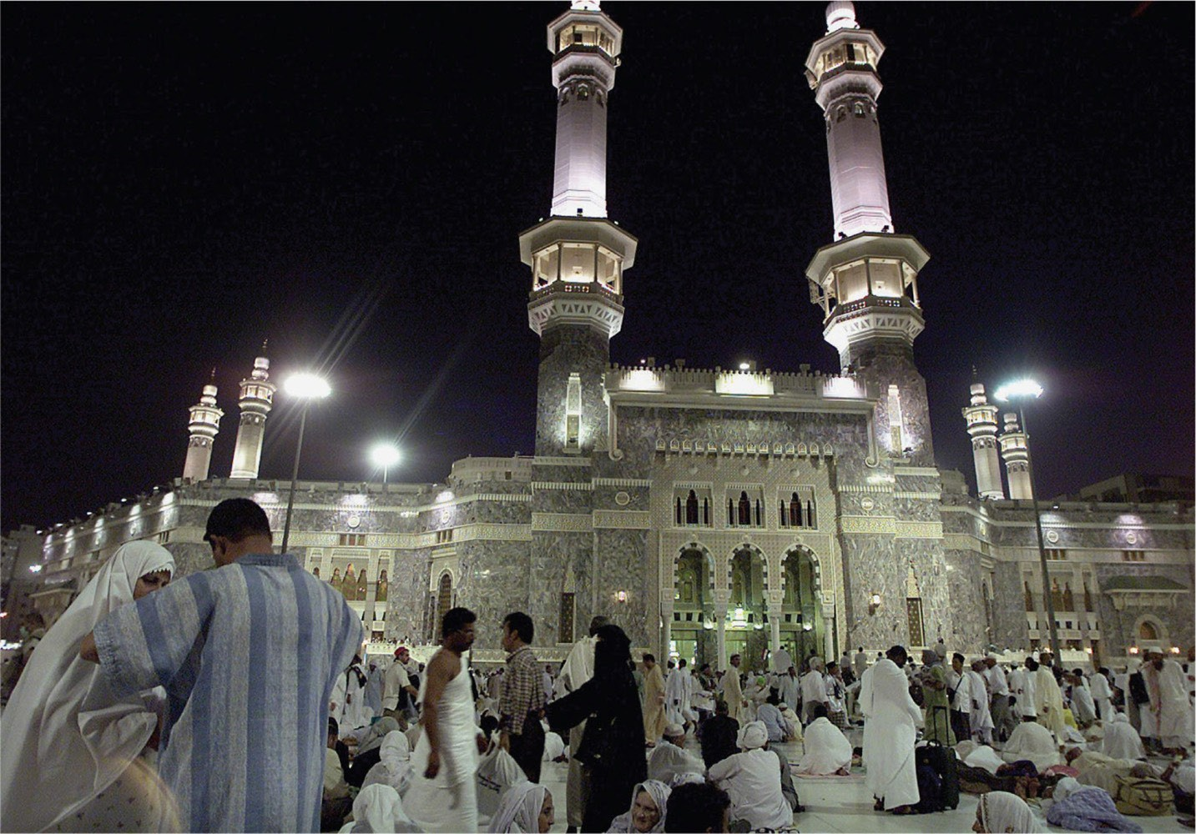
6

Slide 7
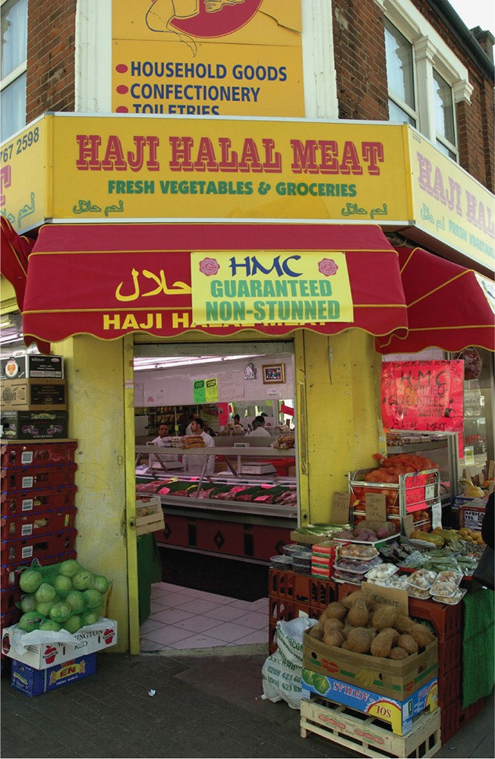
7

Slide 8
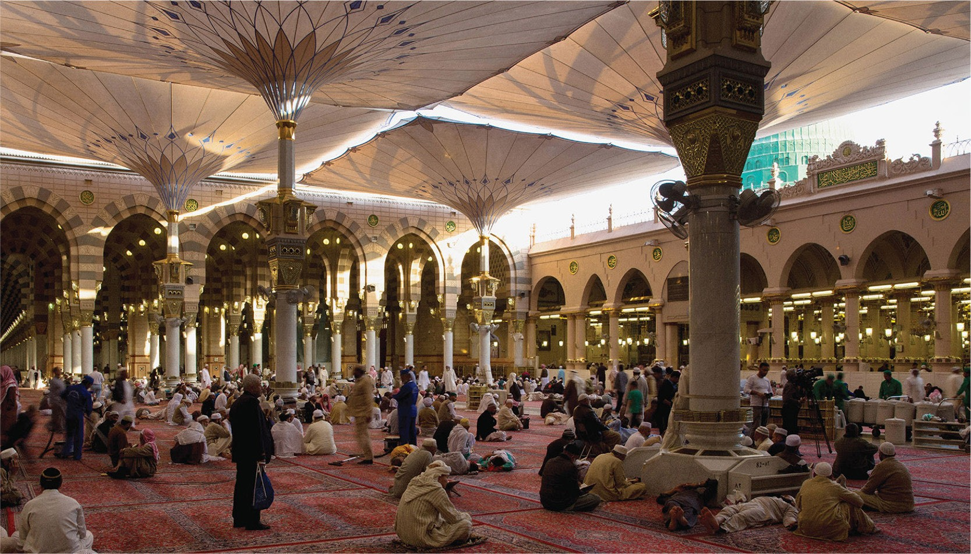
8

Slide 9
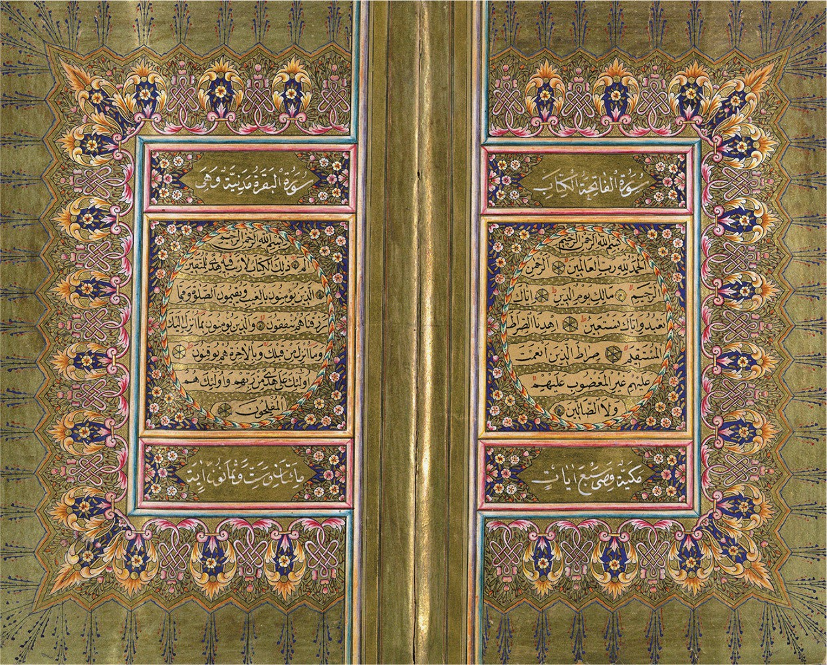
9

Slide 10
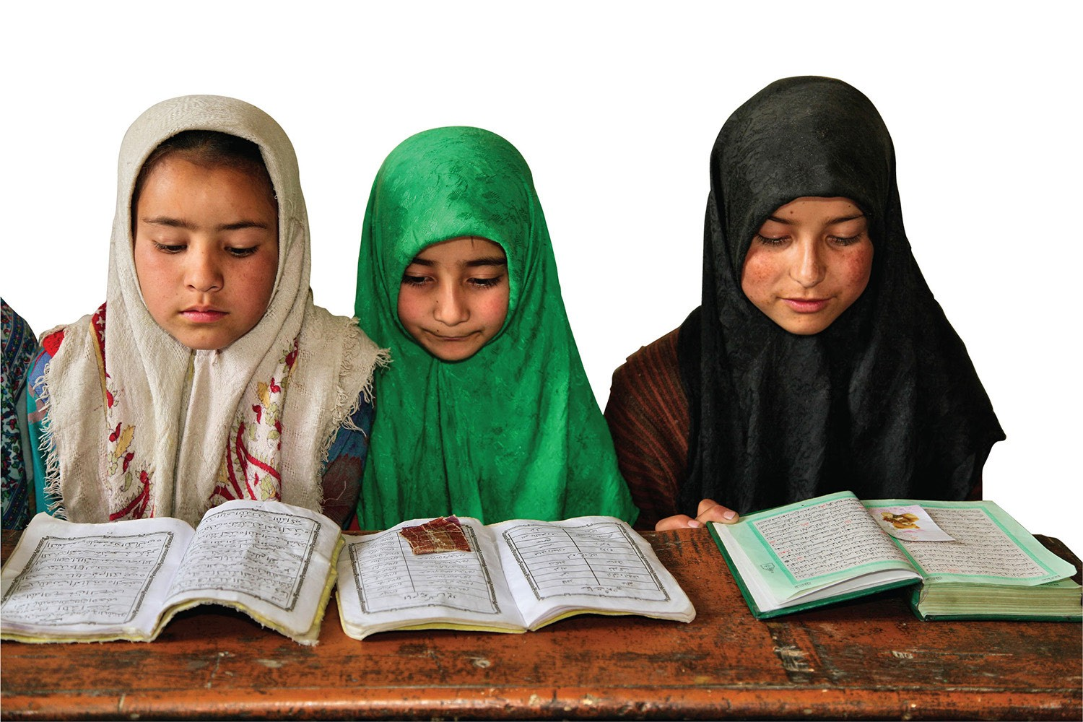
10

Slide 11
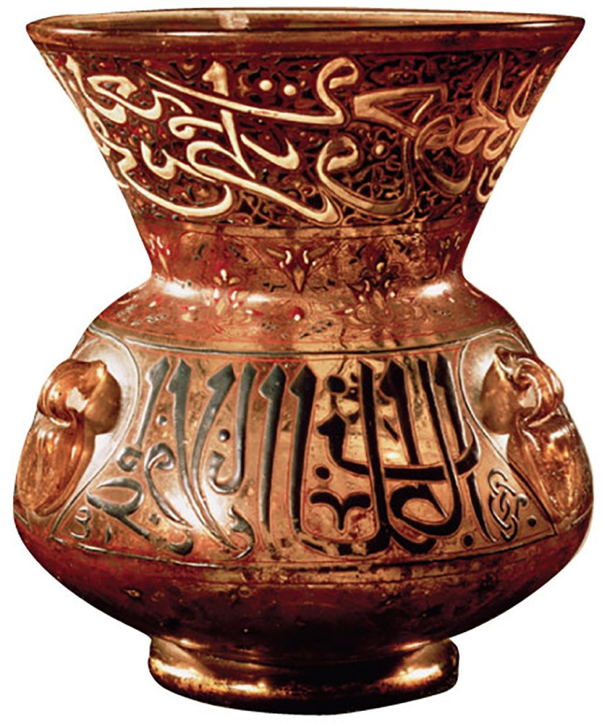
11

Slide 12
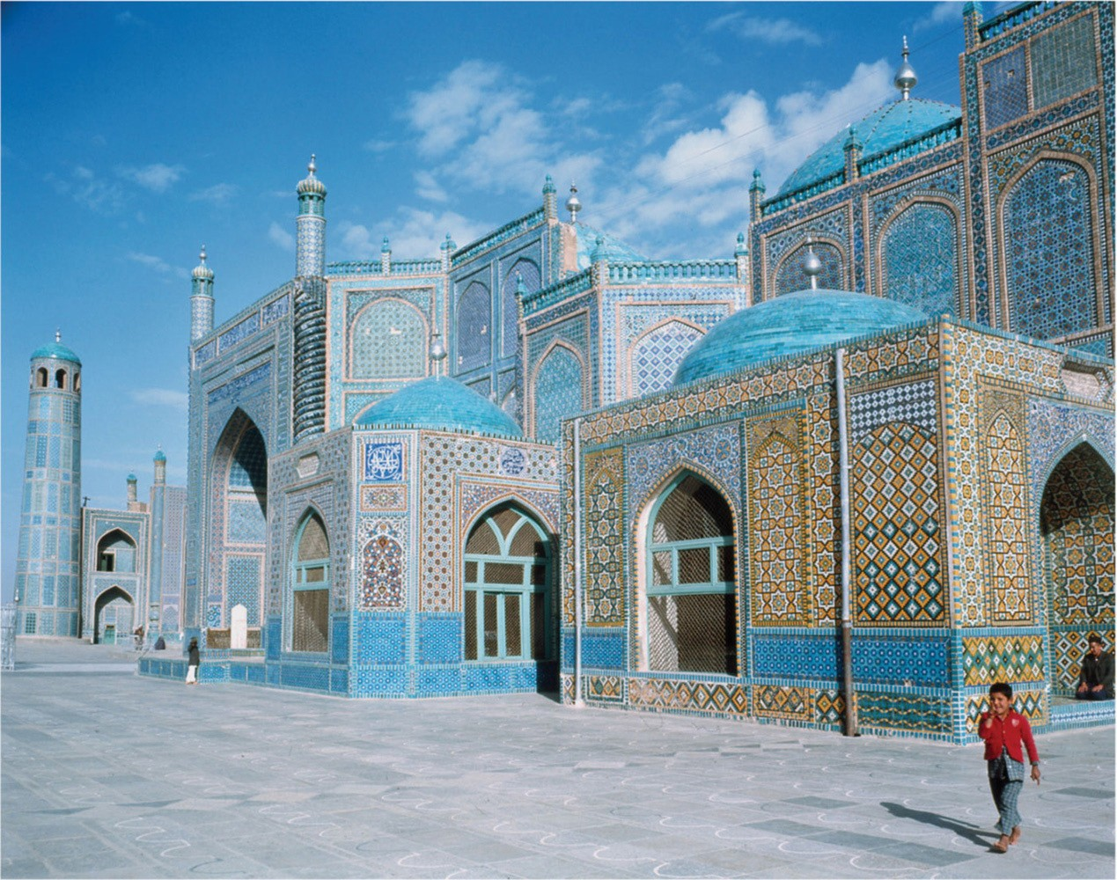
12

Slide 13
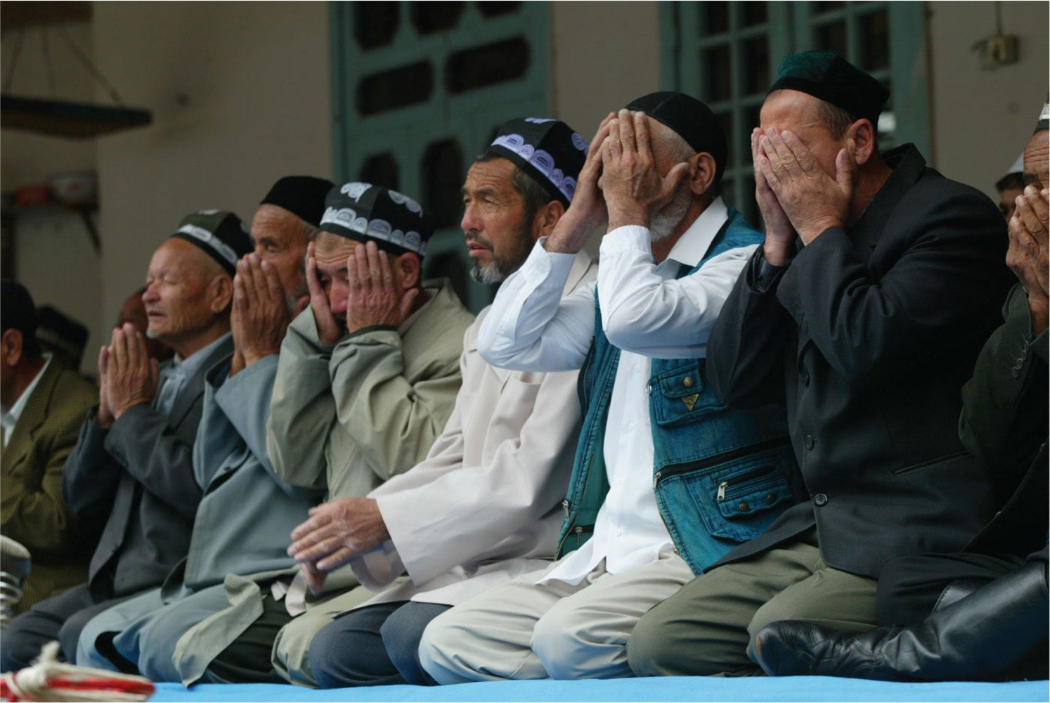
13

Slide 14
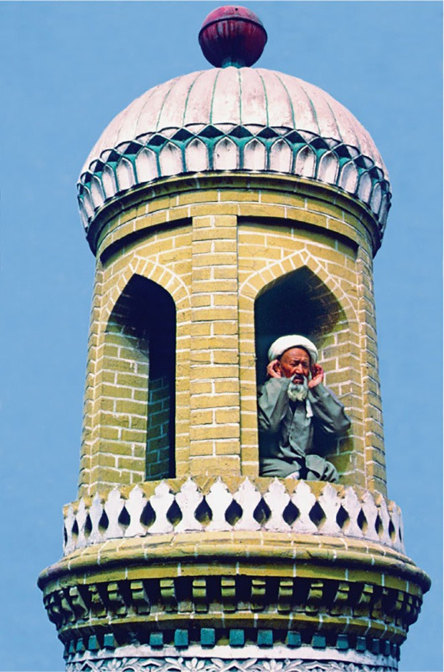
14

Slide 15
15

Slide 16
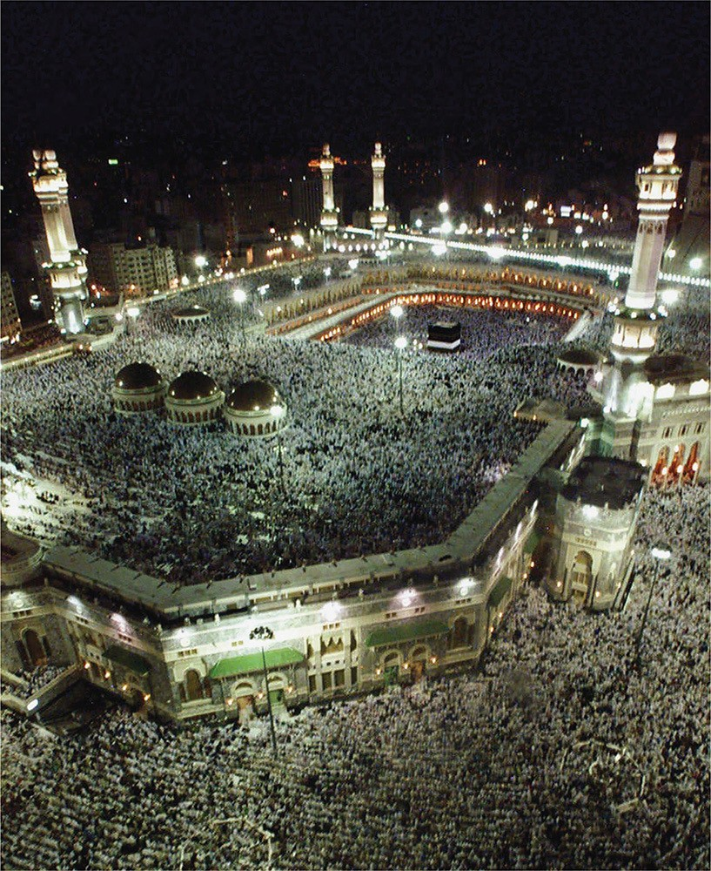
16

Slide 17
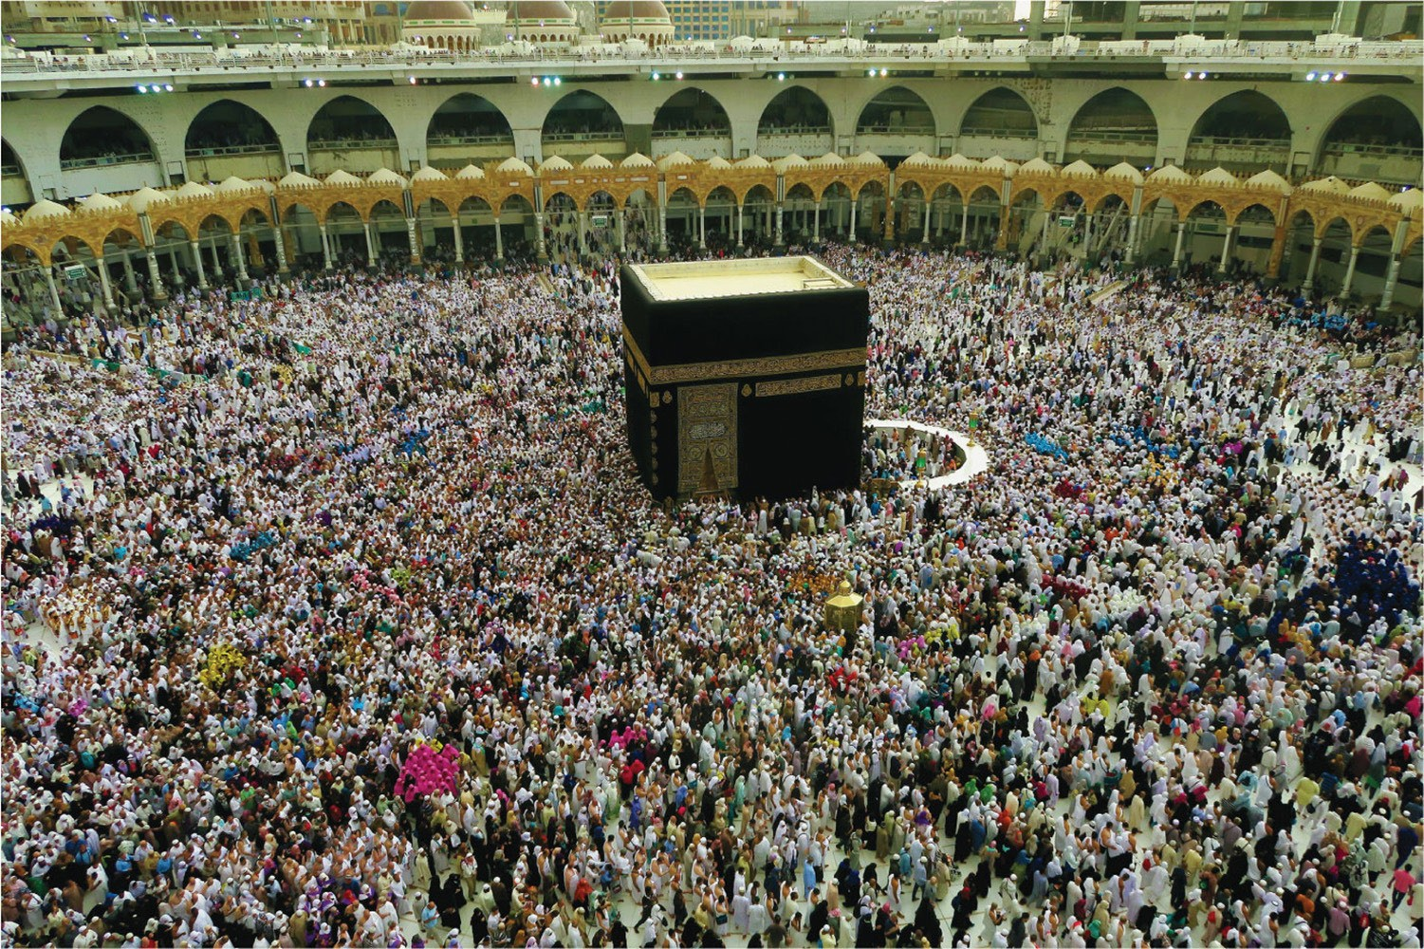
17

Slide 18
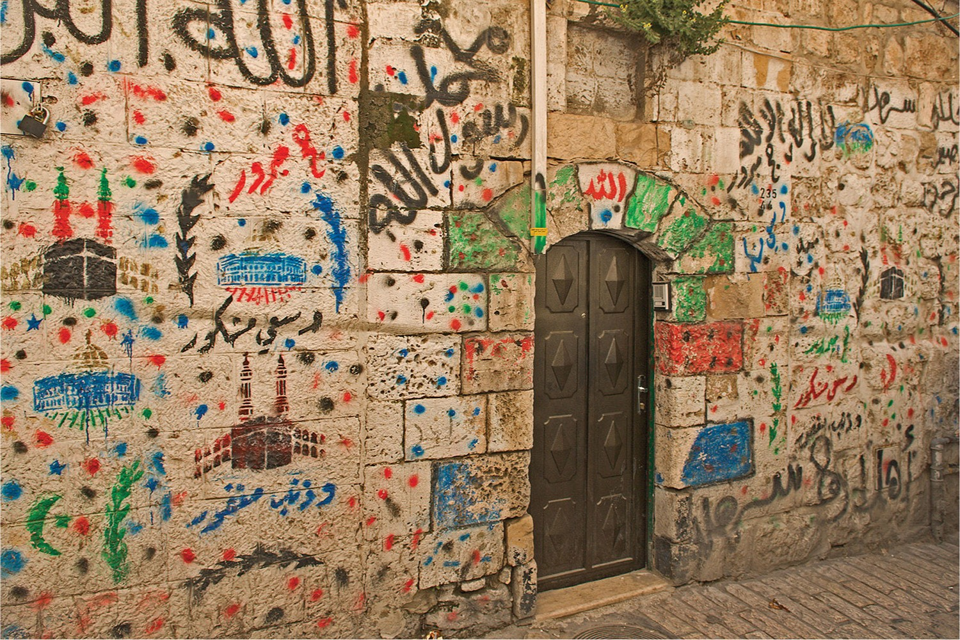
18

Slide 19
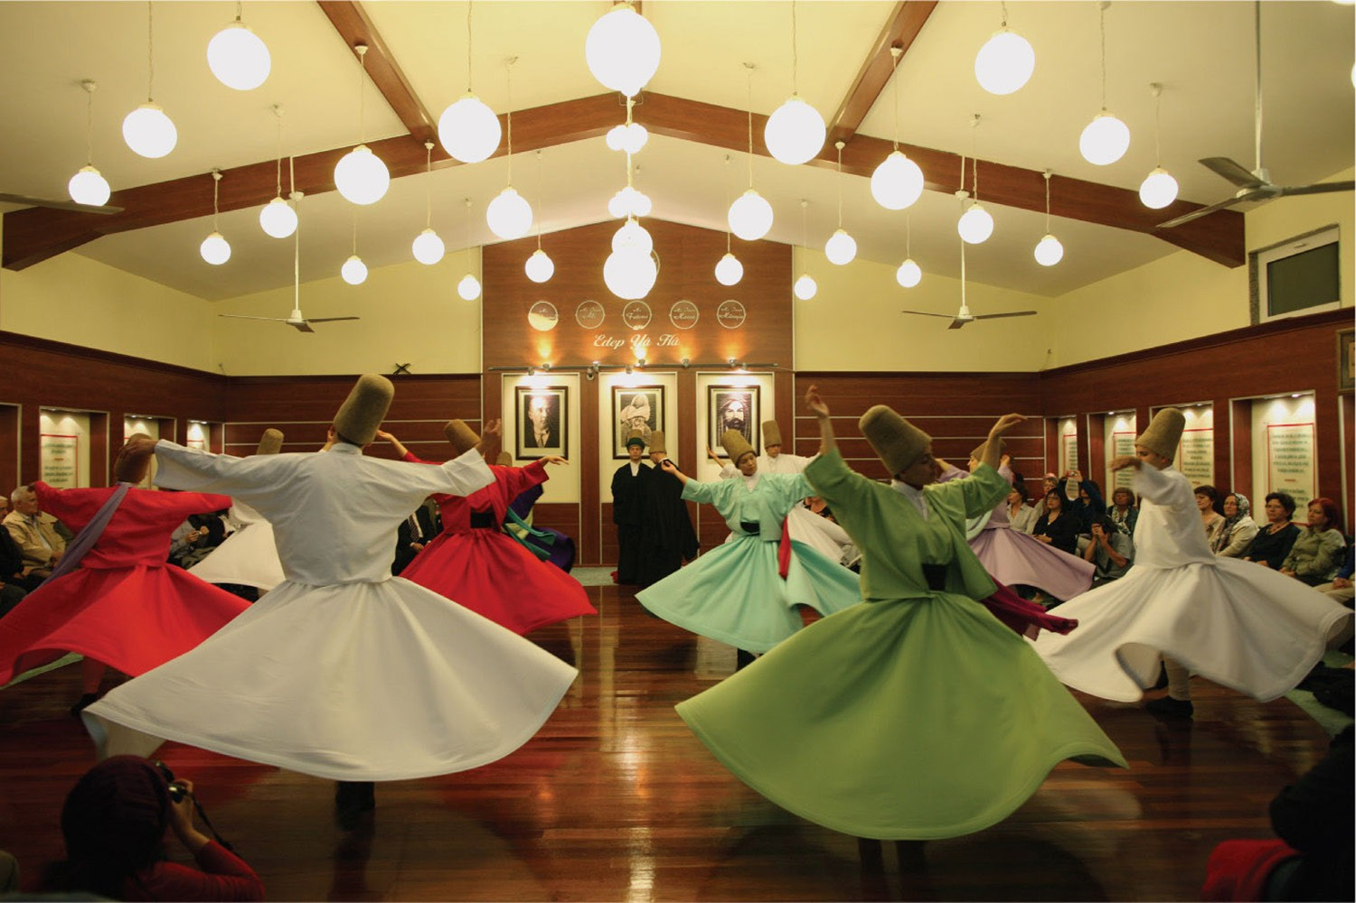
19

Slide 20
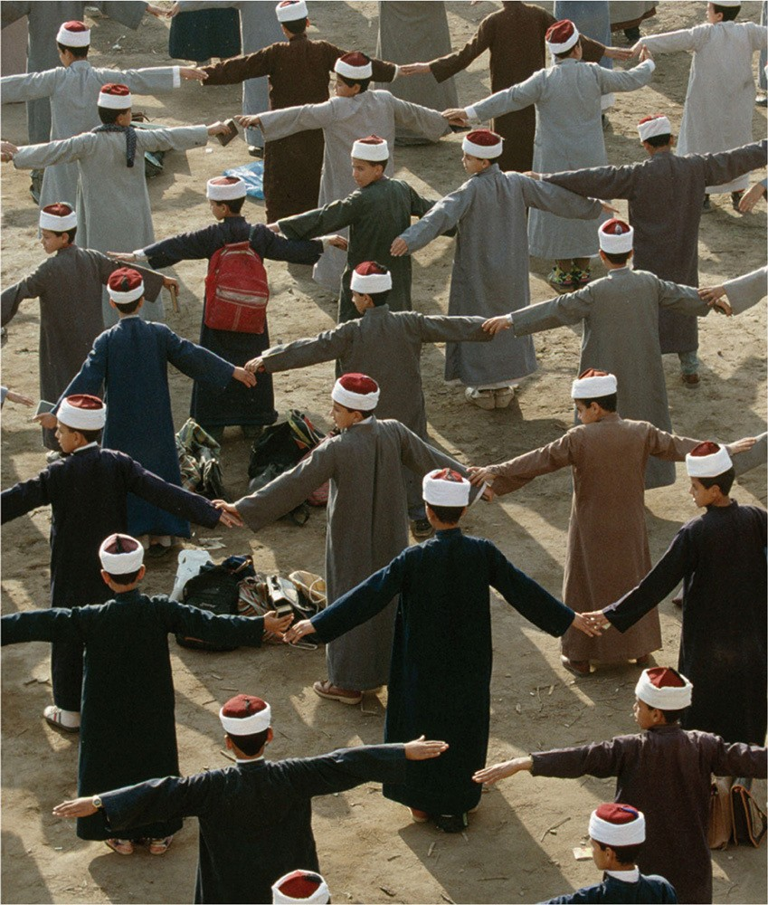
20

Slide 21
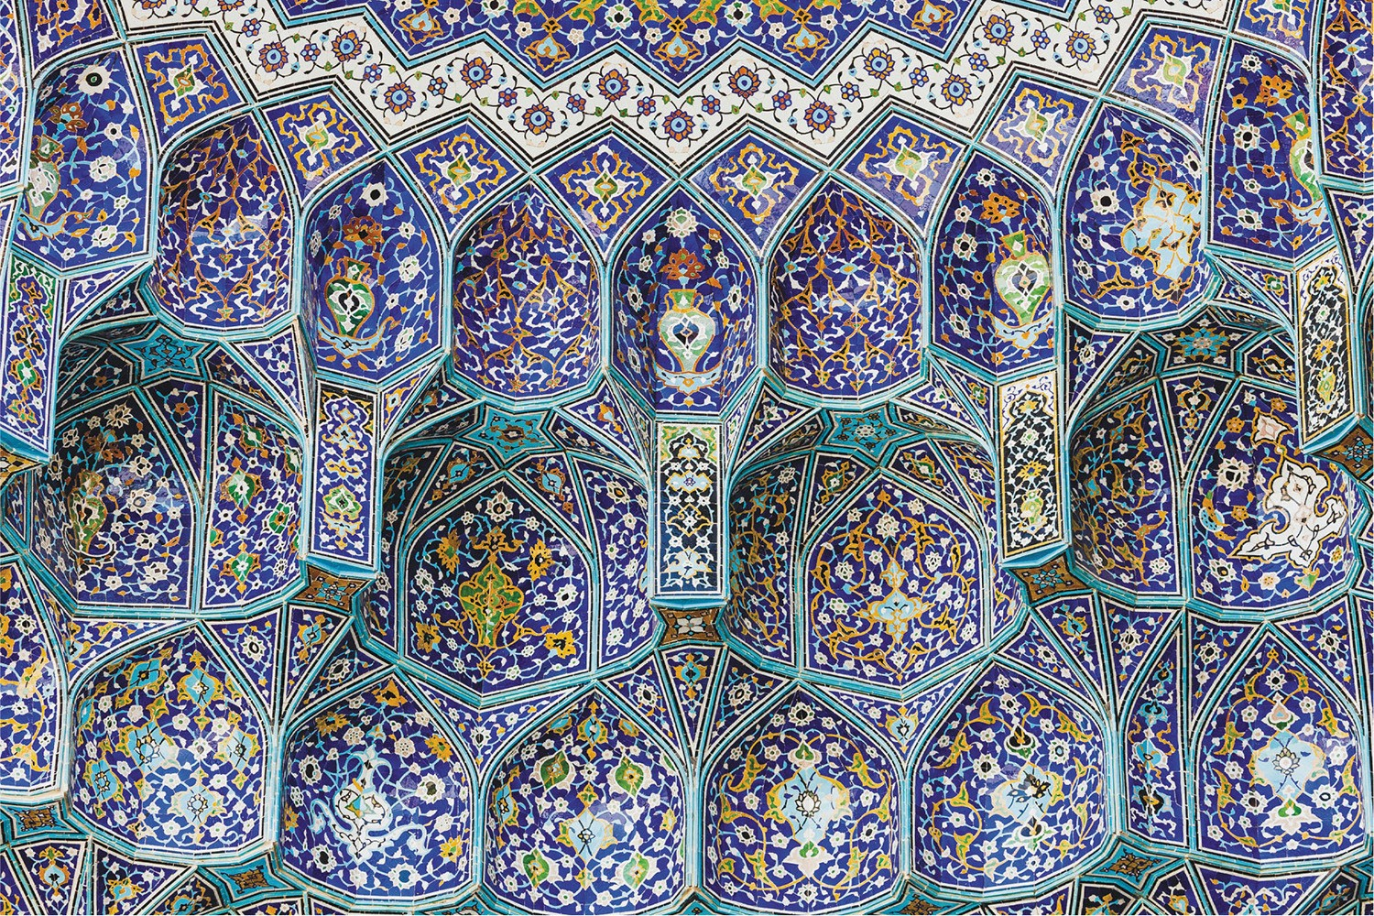
21

Slide 22
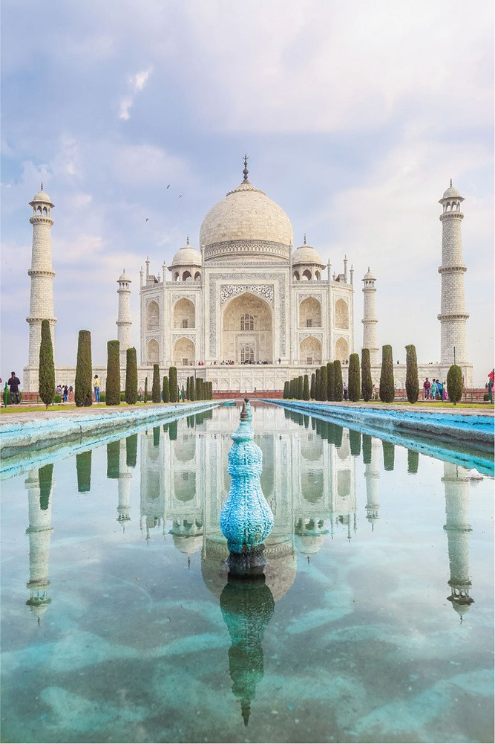
22

Slide 23
23

Slide 24
24

Slide 25
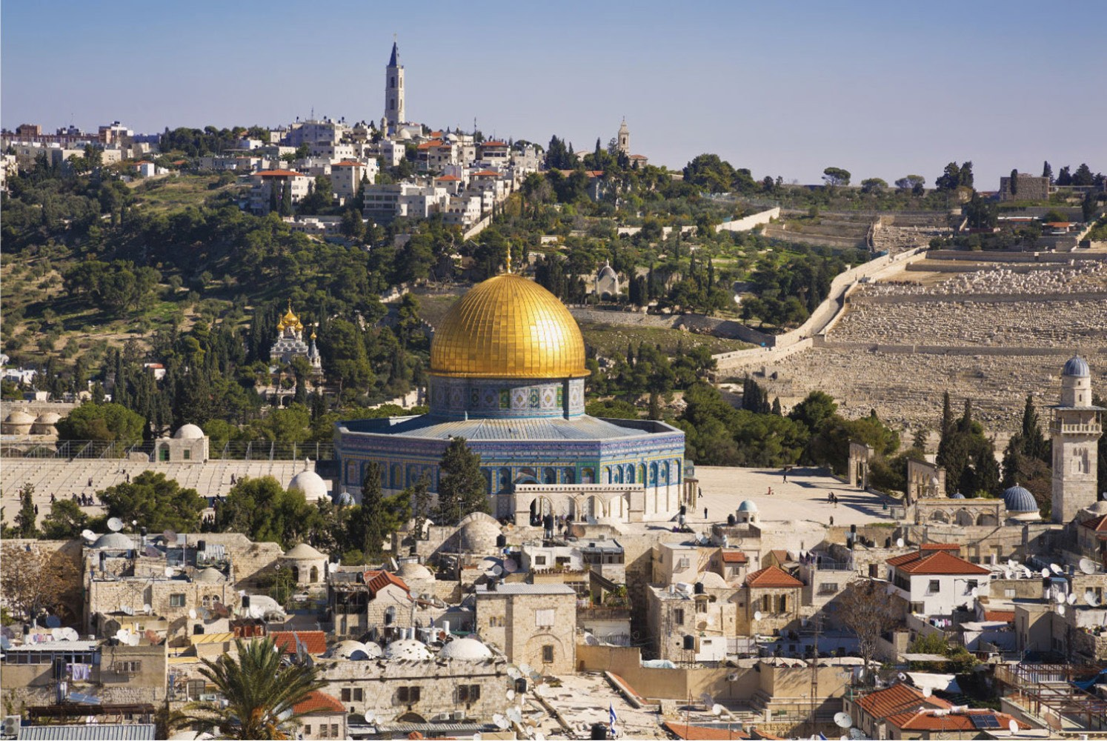
25

Slide 26
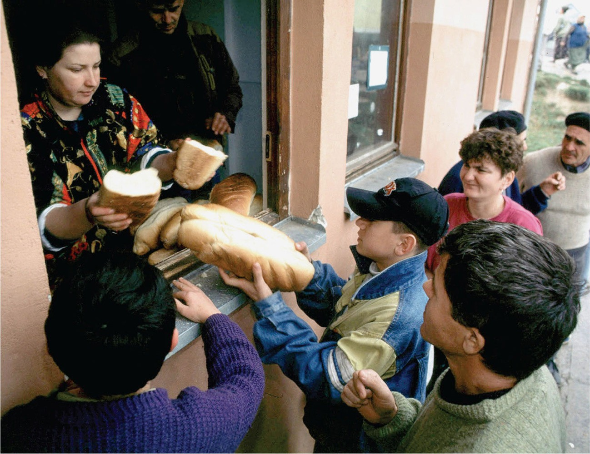
26

Slide 27
27

Slide 28
28

Slide 29
29

Slide 30
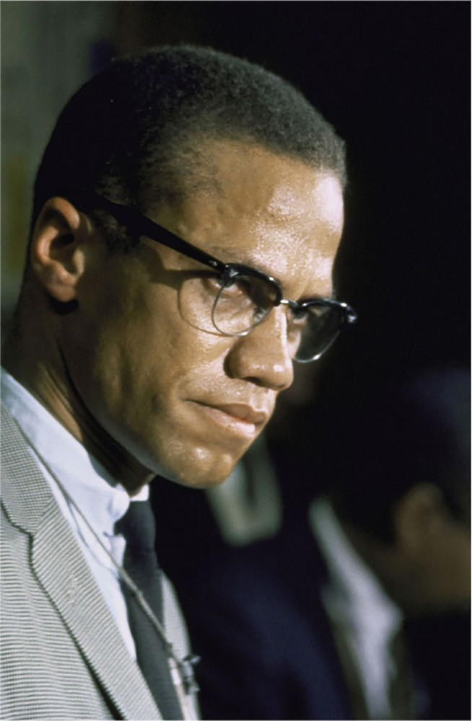
30

Slide 31
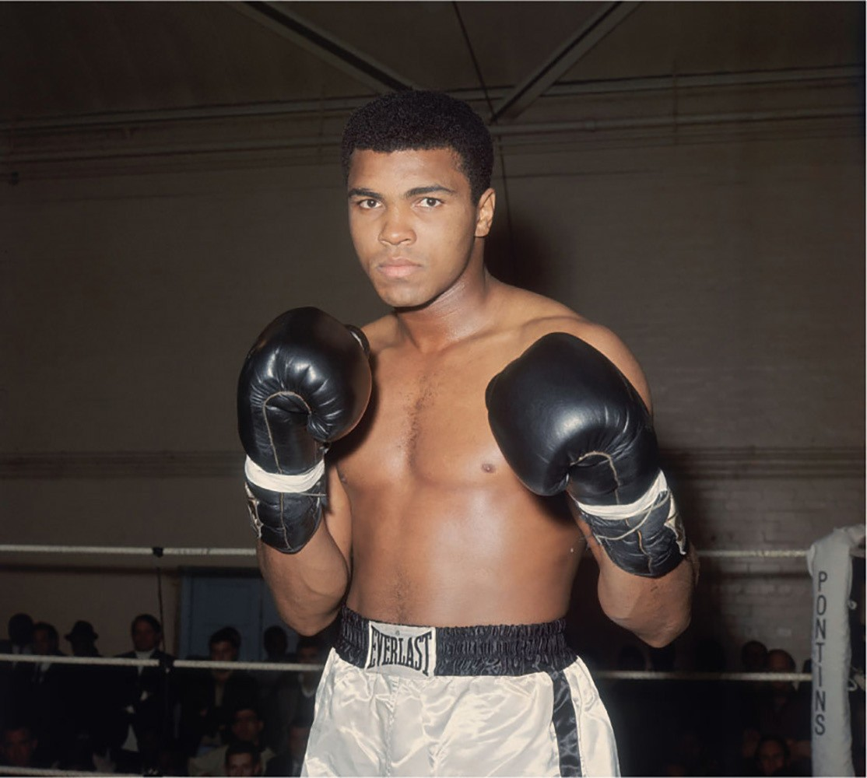
31

Slide 32
32

Slide 33
33

Slide 34
34

Slide 35
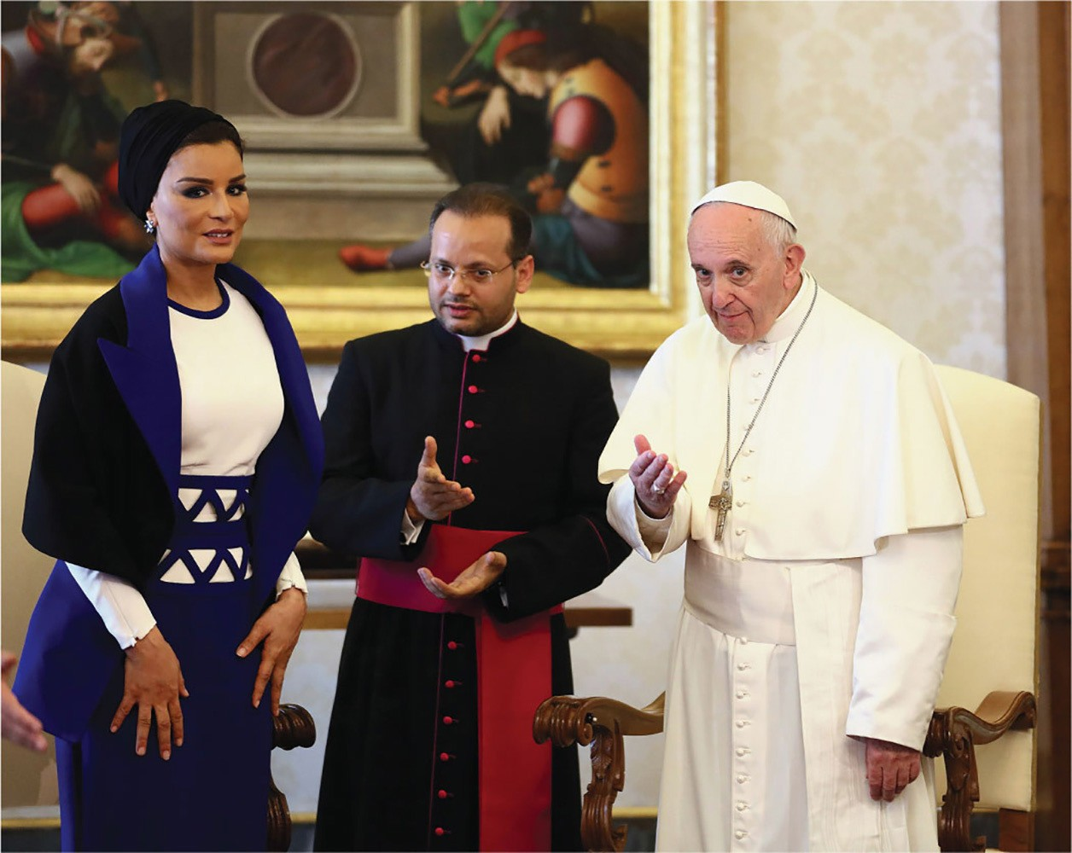
35

Slide 36
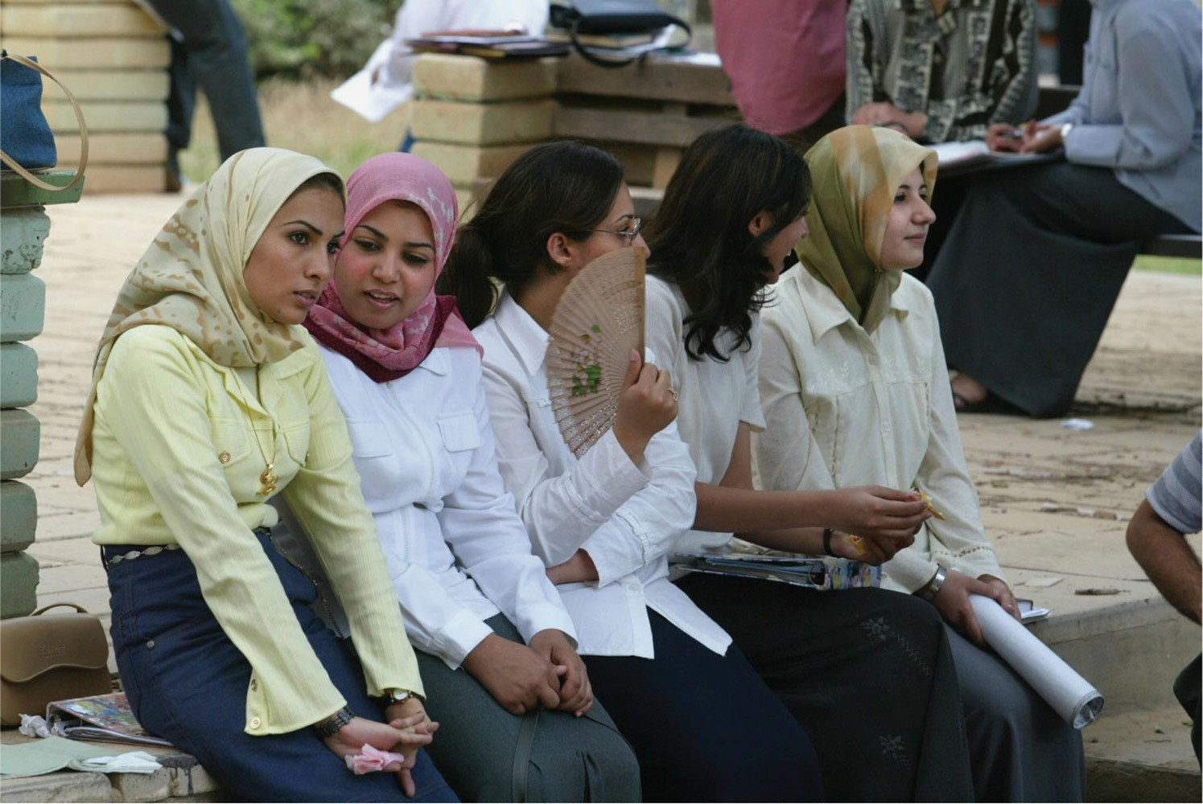
36

Slide 37
37

